Slide 1

R for Excel Users
Slides accompanying workshop lessons: rstd.io/conf20-r-excel
RStudio::conf(2020)
Instructors: Dr. Julie Lowndes
Dr. Allison Horst
TAs: Jamie Montgomery
Jessica Couture

Slide 2

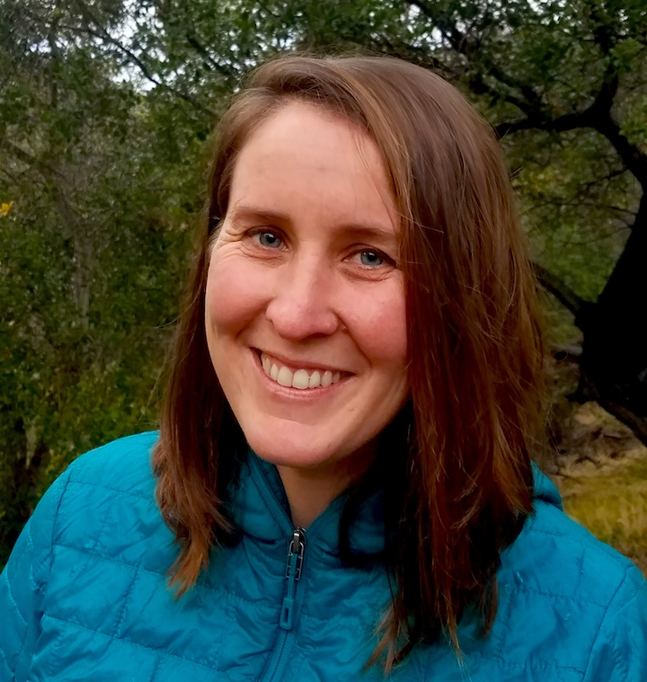
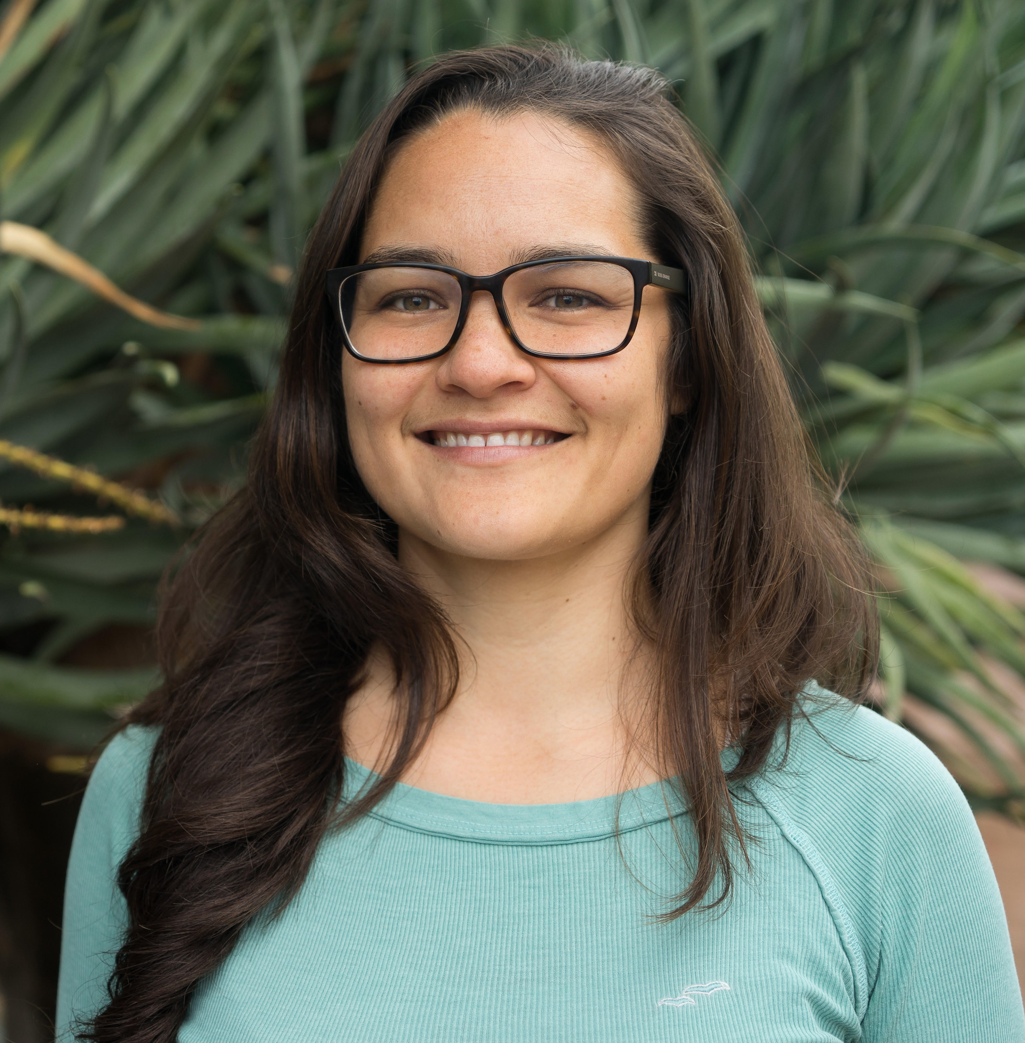

Hello!
JULIE LOWNDES
Please call me: Julie
My Twitter: @juliesquid
My GitHub: jules32
My pronouns: she/her
ALLISON HORST
Please call me: Allison
My Twitter: @allison_horst
My GitHub: allisonhorst
My pronouns: she/her
JESSICA COUTURE
Please call me: Jessica
My Twitter: @ECOture9
My GitHub: couture322
My pronouns: she/her
JAMIE MONTGOMERY
Please call me: Jamie
My Twitter: @jamiecmonty
My GitHub: jamiecmontgomery
My pronouns: she/her
Notes:
30 seconds to introduce each of us 4

Slide 3
Logistics
Restrooms: by the elevator
Wifi: rstudio20, password tidyverse20
Lunch: Golden Gate Foyer (Lobby Level)
Reception: 5:30-7:30 Yosemite
Code of Conduct
Asking for help
I have a question
Help please
I’m fine!

Slide 4
Please put a blue sticky note on your computer if you have successfully done the following:
Download and install R and RStudio
R: https://cloud.r-project.org/
RStudio: http://www.rstudio.com/download
Create a GitHub account
GitHub: https://github.com
Follow optional advice on choosing your username
Download and install Git
Git: https://git-scm.com/downloads
Follow your operating system’s normal installation process. Note: you will not see an application called Git listed
Download workshop data
Google Drive folder: r-for-excel-data
Notes:
You are all welcome here.
We are here to learn hands-on how to begin to interoperate between Excel and R.
Everyone is coming to this workshop with different experiences and skillsets; please be respectful of one another.
Everyone in this workshop is coming from a different place with different experiences and expectations. But everyone will learn something new here, because there is so much innovation in the data science world.
Instructors and helpers learn something new every time, from each other and from your questions. If you are already familiar with some of this material, focus on how we teach, and how you might teach it to others.
Use these workshop materials not only as a reference in the future but also for talking points so you can communicate the importance of these tools to your communities. A big part of this training is not only for you to learn these skills, but for you to also teach others and increase the value and practice of open data science in science as a whole.

Slide 5

You are all welcome here
All artwork by Allison Horst
Notes:
You are all welcome here.
This workshop is all about welcoming Excel users to the world the world of R.
It’s going to be a fun and empowering workshop.
Everyone in this workshop is coming with different experiences and expectations. Please be respectful of each other. Everyone is going to learn new things today, even us; we learn so much each time we teach because of your questions and insight. If you have a question we want you to feel comforatable raising your hand
If you are already familiar with some of this material, focus on how we teach, and how you might teach it to others.
Some of you in this room are seasoned Excel users, some of you are taking your first step into data analysis.

Slide 6
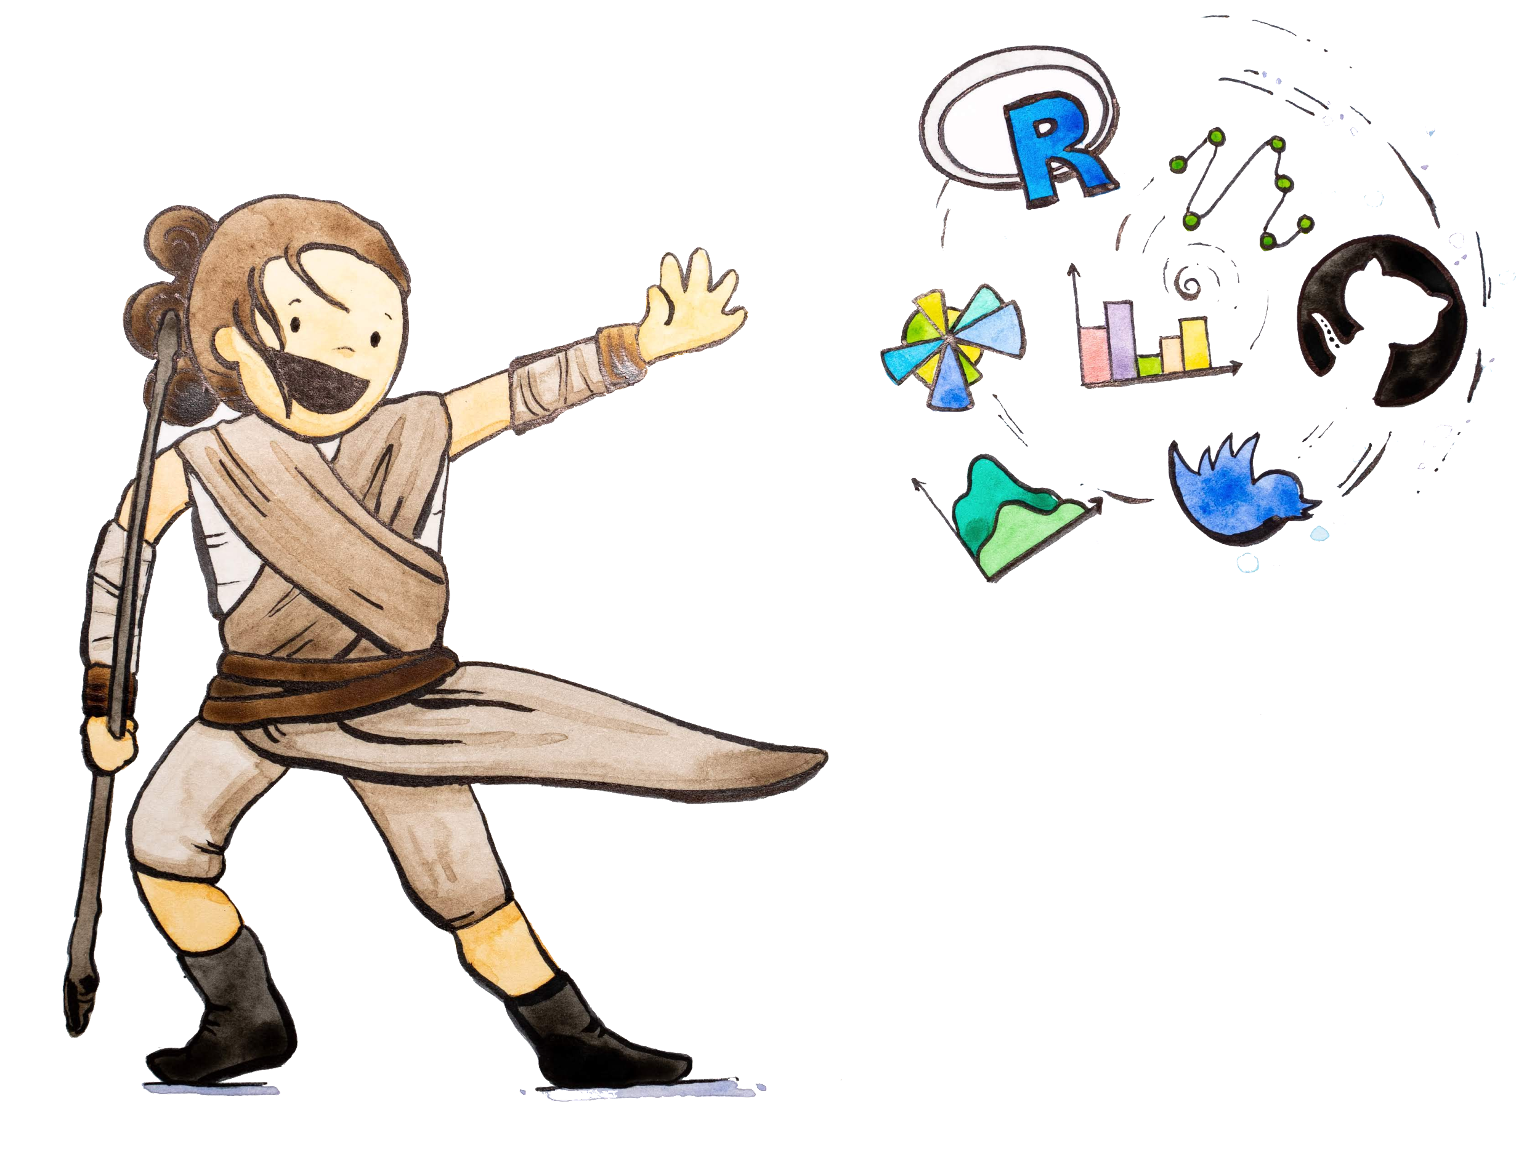
Notes:
We all feel like this because of the community. And we’re going to do our best to help you feel like this as well.

Slide 7
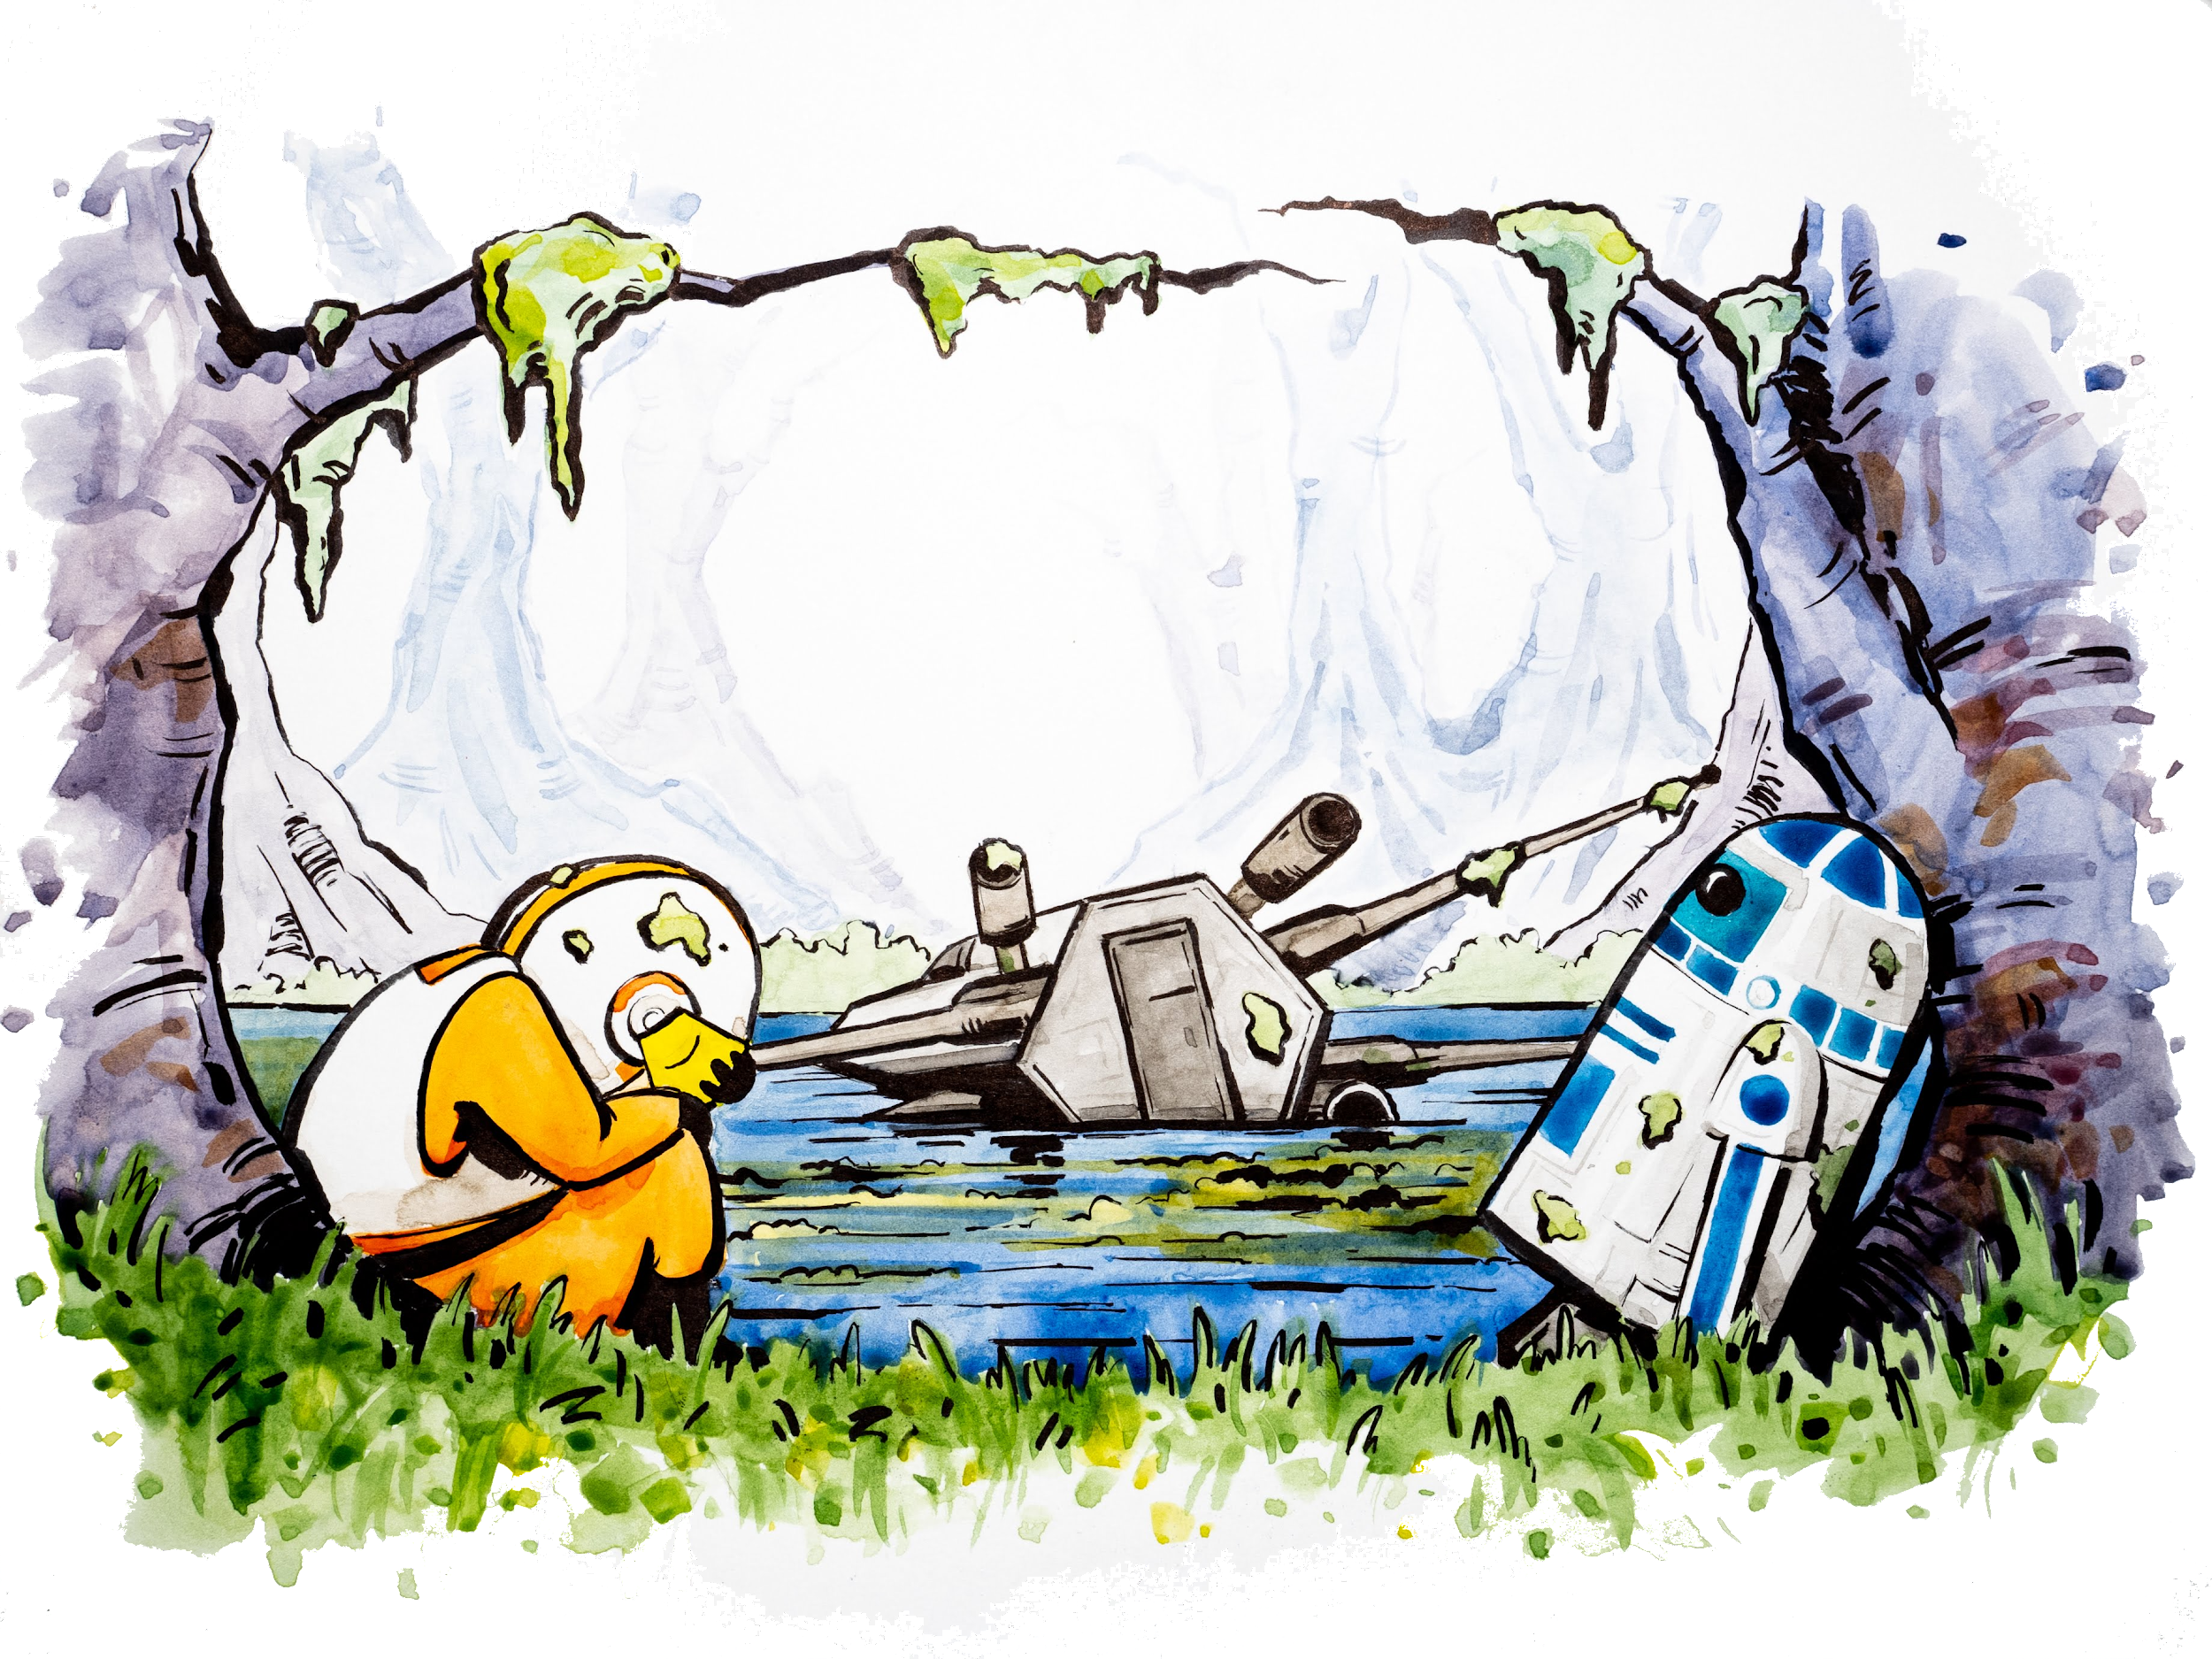
Notes:
No matter how awesome we are at analyses/excel, we can feel like Luke (repetitive tasks, asking if you want to save changes)

Slide 8

Notes:
Yoda knows the Force (R/Rmd/tidyverse GitHub: everything we’ll learn today)

Slide 9
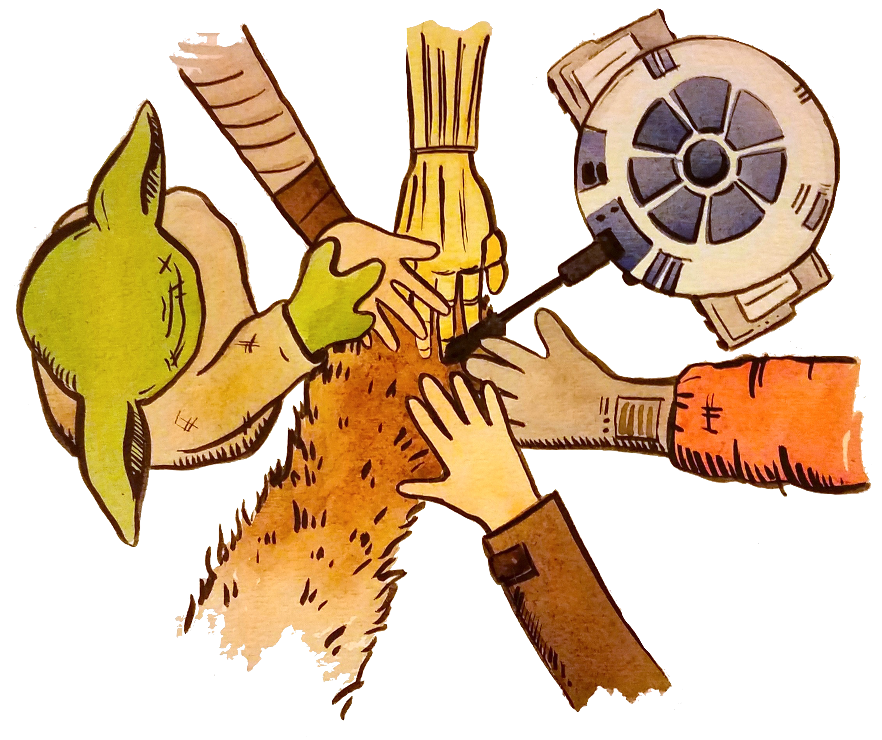
Notes:
Teamwork: this is the R community here at this conference. Developers, users, educators, it’s the best

Slide 10
Becoming a modern useR means developing skillsets, habits, and mindsets for working in a reproducible and collaborative way
We will learn:
1. coding with best practices (RStudio/tidyverse)
2. collaborative bookkeeping (Git/GitHub)
3. reporting and publishing (RMarkdown/GitHub)
Notes:
This workshop is not only about learning R; we are going to learn a whole ecosytem of tools and practices will help us develop good habits for working in a reproducible and collaborative way — critical attributes of the modern analyst.
Not about wholesale learning everything you can do I excel in r
We will learn technical skills that you can incrementally incorporate into your existing workflows. But a big part of interfacing between Excel and R is not only skillsets, it is mindsets. It is the mindset about how we think about data. How we shape data and organize data and analyze data. And how what we do now can make our analytical life better in the future.

Slide 11
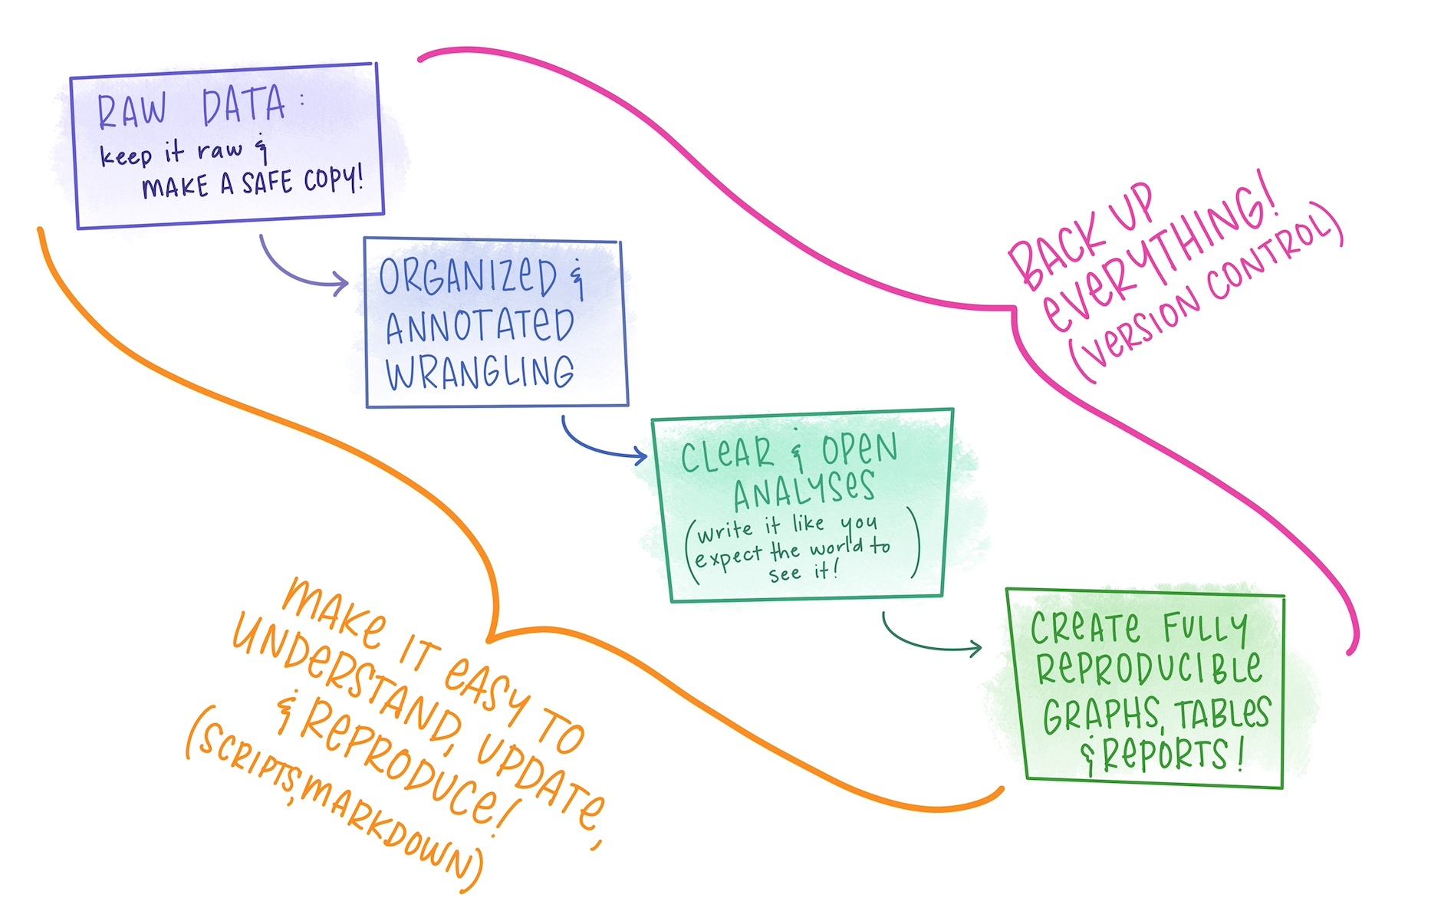
Notes:
Our process is going to look like this.
We’re going to start with our data, and keep it raw as we wrangle it in an organized and annotated way.
Our analyses will be clear and written in an open way, meaning expecting that others will want to read and understand it (this is important because those other people will most likely be you)!
And we will create fully reproducible graphs, tables, and reports.
We’re also going to back everything up with version control and use software to take care of bookkeeping
And we’ll make it easy to understand and reproduce and

Slide 12
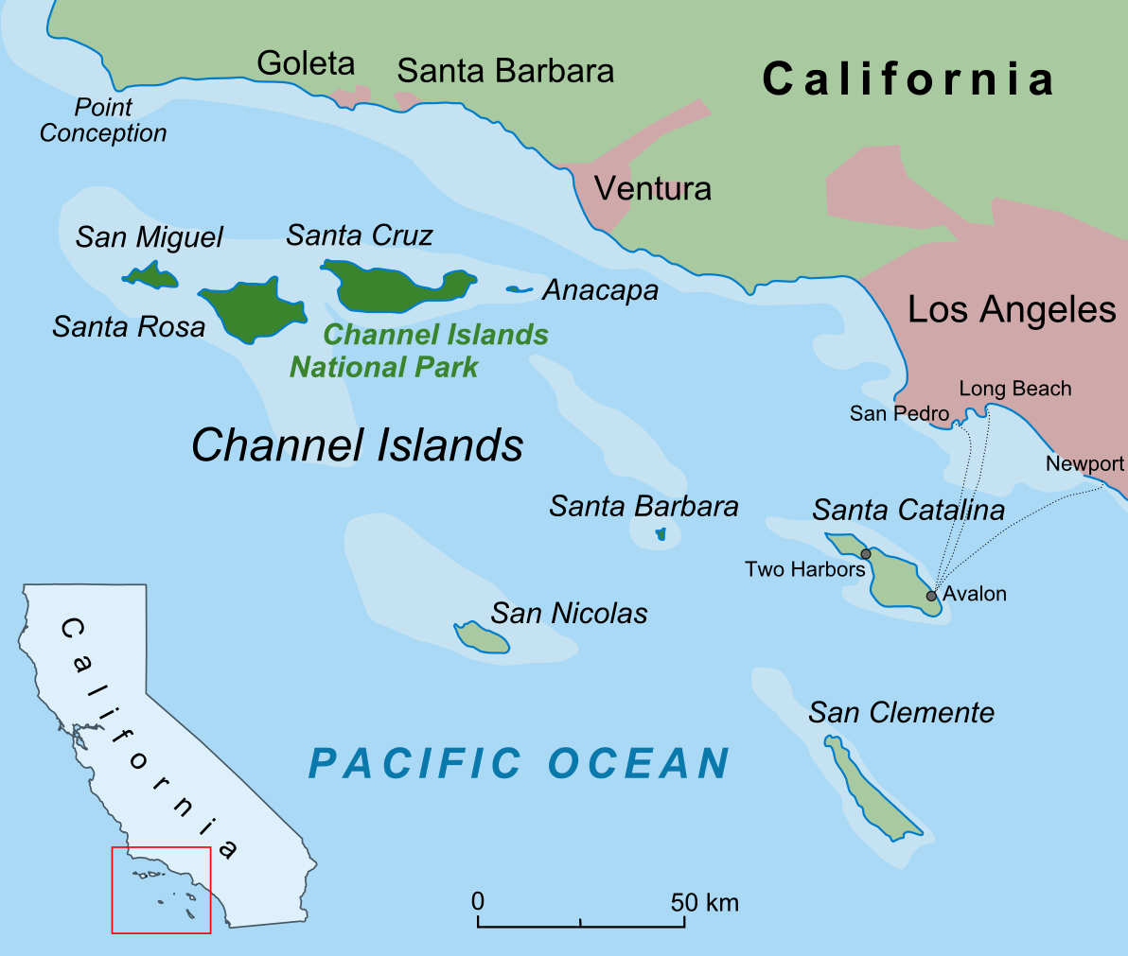
Our workshop data
is primarily from the
Santa Barbara Coastal Long-Term Ecological Research Network
en.wikipedia.org/wiki/Channel_Islands_(California)
Notes:
Our workshop data is primarily from the SB Long-Term Ecological Research Network.
Santa Barbara is where the 4 of us are based, it’s down the coast in California. We are up in the SF bay area now. The data are going to be from the SB Channel between the Islands and the coast: it’s data about marine fish and invertebrates.
This is purposely different from your day-to-day data;
Importance of learning with data that’s not your own. This data has years like your data might (ours are years), it has categories that your data might (ours might be locations, yours might be companies or orders or individuals)
This idea of learning with data that is not your own is really critical for us because –
The Long Term Ecological Research Network (LTER) consists of a group of over 1800 scientists and students studying ecological processes over extended temporal and spatial scales. Twenty-six LTER sites cover a diverse set of ecosystems. It is part of the International Long Term Ecological Research Network (ILTER)

Slide 13
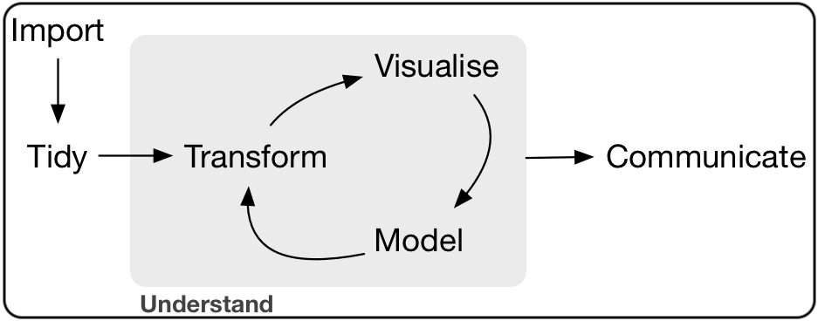
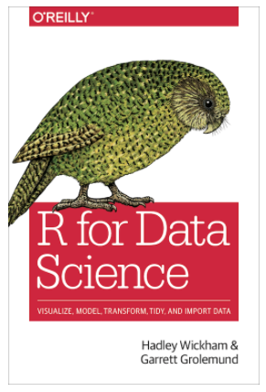
Wickham & Grolemund 2016
Notes:
And this is what data science looks like.
In data science, no matter what your data, what your question, you will have to go through this process.
Import: You will need to get it from whereever it is into software to analyze it.
Tidy:
Understand:
Communicate.
This wrangling. Getting your data tidy first and then operating on it rather than accommodating any weird way
Mention tidy data. Explain what tidy means: format/clean/wrangle

Slide 14
Wrangle
Wickham & Grolemund 2016
Notes:
And this is what data science looks like.
In data science, no matter what your data, what your question, you will have to go through this process.
Import: You will need to get it from whereever it is into software to analyze it.
Tidy:
Understand:
Communicate.
This wrangling. Getting your data tidy first aand then operating on it rather than accommodating any weird way
Mention tidy data. Explain what tidy means: format/clean/wrangle

Slide 15
Becoming a modern useR means developing skillsets, habits, and mindsets for working in a reproducible and collaborative way
We will build the mindset:
1. to expect that what you want to do is possible
2. to have confidence you can find it
3. to continue learning with supportive community
4. to enable others
Notes:
This workshop is not only about learning R; we are going to learn a whole ecosytem of tools and practice will help us develop good habits for working in a reproducible and collaborative way — critical attributes of the modern analyst.

Slide 16
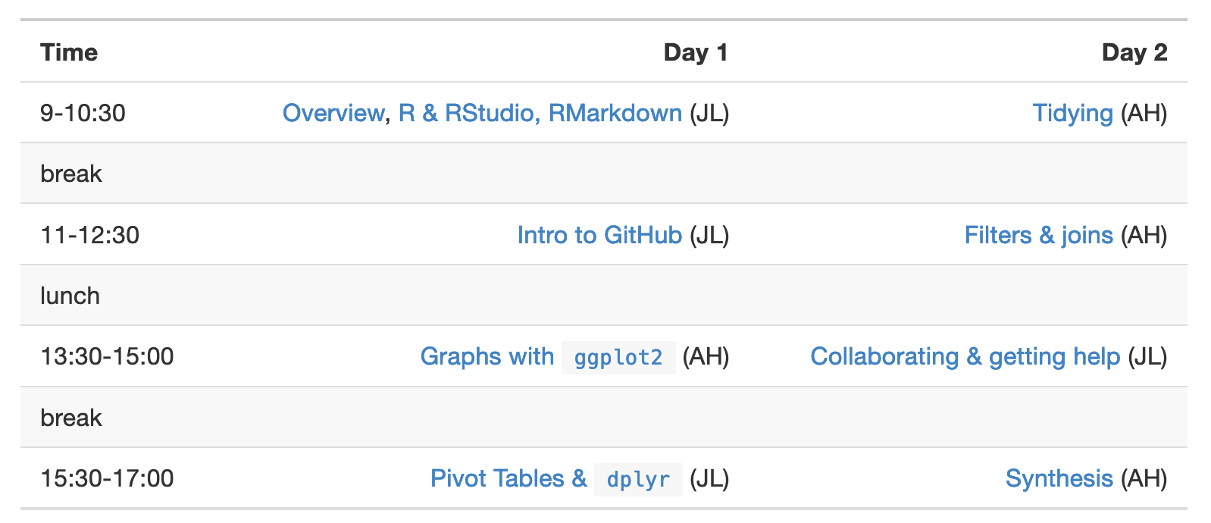
Agenda
Workshop book: rstd.io/conf20-r-excel
Notes:
Use these workshop materials not only as a reference in the future but also for talking points so you can communicate the importance of these tools to your communities. A big part of this training is not only for you to learn these skills, but for you to also teach others and increase the value and practice of open data science in science as a whole.

Slide 17
Session 1: R, RStudio, R Markdown

Slide 18
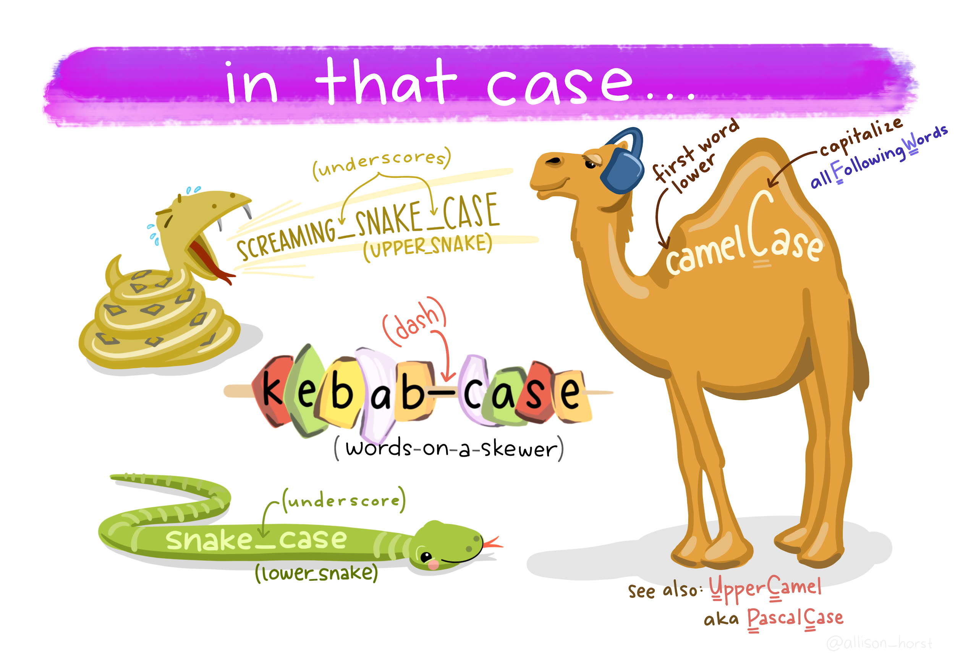

Slide 19
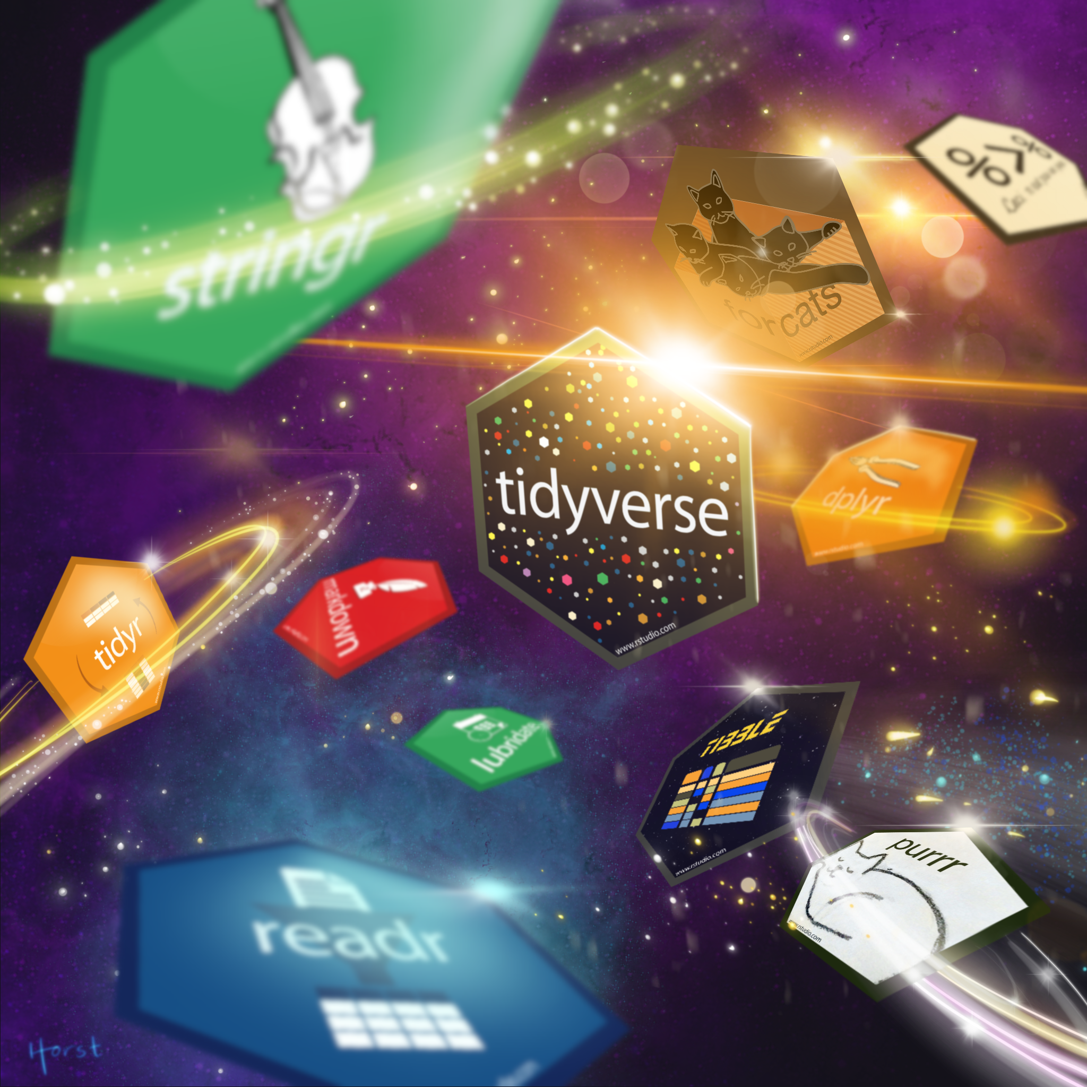
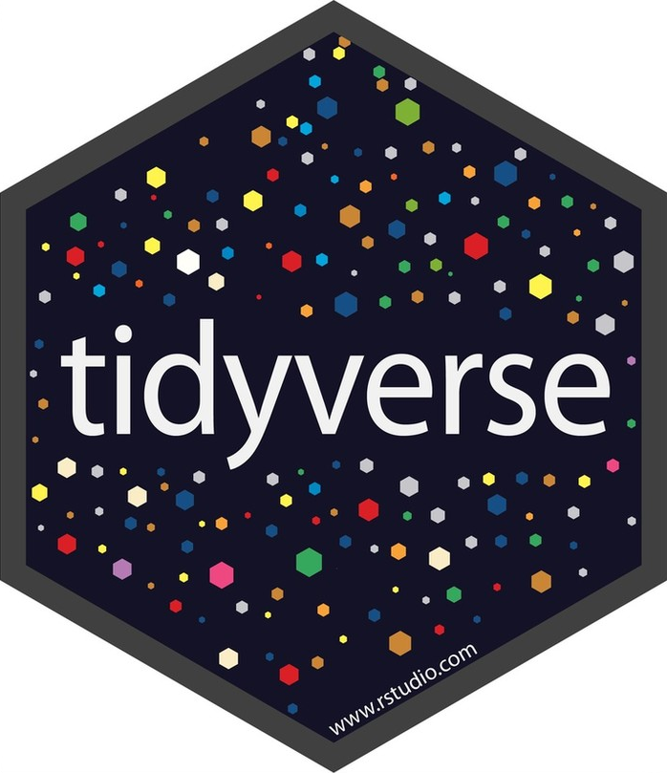
“The tidyverse is a coherent system of packages for data manipulation, exploration and visualization that share a common design philosophy.”
Joseph Rickert
What is the tidyverse?
RStudio Community Blog

Slide 20
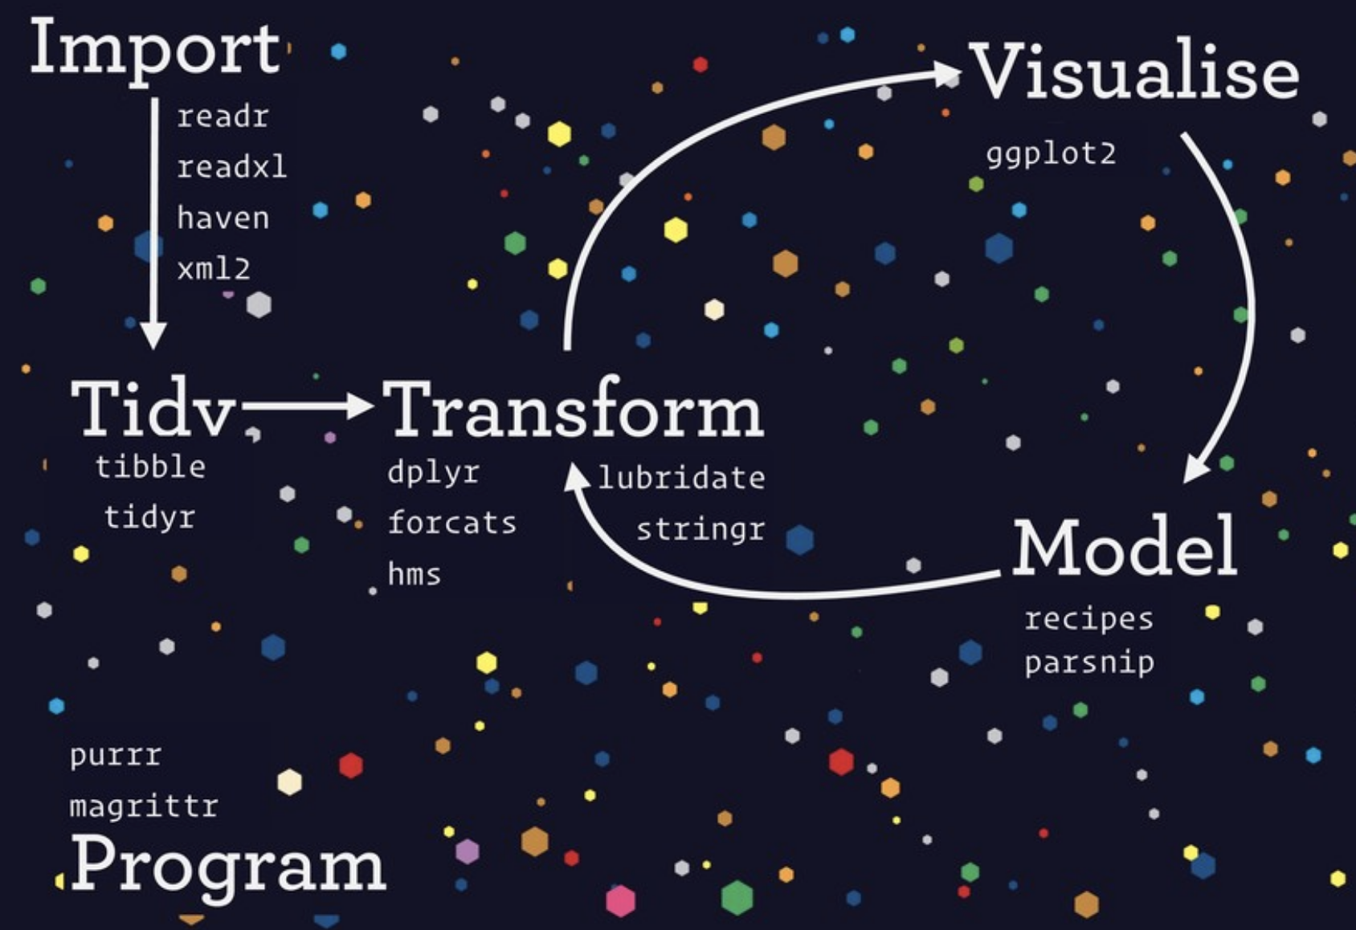
shiny
rmarkdown
Communicate

Slide 21
Session 2: GitHub

Slide 22
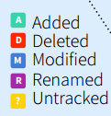
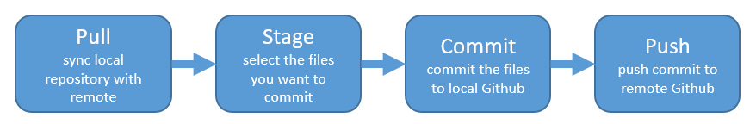

Slide 23
Session 3: ggplot2

Slide 24
“ggplot2 is a system for declaratively creating graphics, based on The Grammar of Graphics. You provide the data, tell ggplot2 how to map variables to aesthetics, what graphical primitives to use, and it takes care of the details.”
https://ggplot2.tidyverse.org/

Slide 25
Tell R you’re using ggplot
What data frame are you getting the variables from?
What variable(s) do you want to plot?
What type of graph do you want to make (geom_)?
ggplot(data = df, aes(x = var_x, y = var_y)) +
geom_?()
plus sign between layers, not the pipe operator!

Slide 26
Session 4: Pivot tables & dplyr

Slide 27
Wikipedia describes a pivot table as
“a table of statistics that summarizes the data of a more extensive table…this summary might include sums, averages, or other statistics, which the pivot table groups together in a meaningful way.”

Slide 28
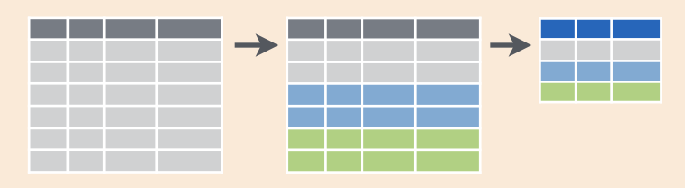
Data → group by → summarize
Source: RStudio's old-school data wrangling cheatsheet
All cheatsheets available from https://rstudio.com/resources/cheatsheets

Slide 29
data %>% group_by() %>% summarize()
%>%
The pipe operator, reads “and then”
“Take the data, and then
group by something, and then
summarize by something”

Slide 30
Data %>%
group_by() %>%
summarize()
%>%
The pipe operator, reads “and then”
“Take the data, and then
group by something, and then
summarize by something”

Slide 31
Welcome to Day 2!
If you did not get an email from me this morning with the kelp_fronds.xlsx file attached, please let one of us know & we’ll email it to you. We’ll use it for Session 2.

Slide 33
What we started learning yesterday:
Meet the RStudio IDE
Working in RMarkdown (2 languages! R + markdown)
Functions, arguments, code syntax & good habits
Writing organized, reproducible code, and the pipe operator (%>%)
Installing & attaching packages
Storing objects (<-)
Reading in and exploring data (read_csv, read_excel)
Intro to visualization with ggplot2
Pivot tables (group_by + summarize)
An html table with kable
Hello Git + GitHub
Work between Git and RStudio (pull > stage > commit > push)
Whoa.

Slide 34
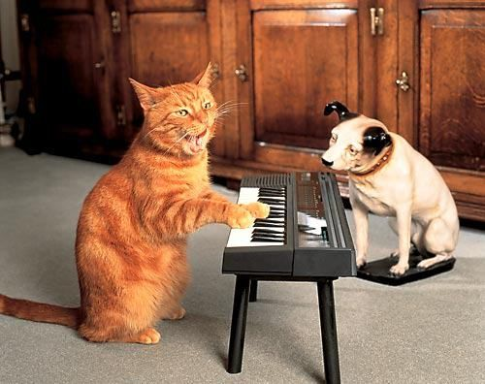
Today, continue all of that PLUS:
Reshaping, cleaning, wrangling data continued
Some fun with strings
Super deliberate filtering
Joining data frames
Collaborating in GitHub
Building your community
Synthesize it!

Slide 35
Session 5: Tidying

Slide 36
What is tidy data?
From R for Data Science by Grolemund & Wickham:
To be “tidy”:
Each variable is a column.
Each observation is a row.
Each value in its own cell.

Slide 37
A variable is a characteristic that is being measured, counted or described with data. Like: car type, salinity, year, population, or whale mass.
An observation is a single “data point” for which the measure, count or description of one or more variables is recorded. For example, if you are recording variables height, mass, and color of dragons, then each dragon is an observation.
A value is the recorded measure, count or description of a variable.

Slide 38
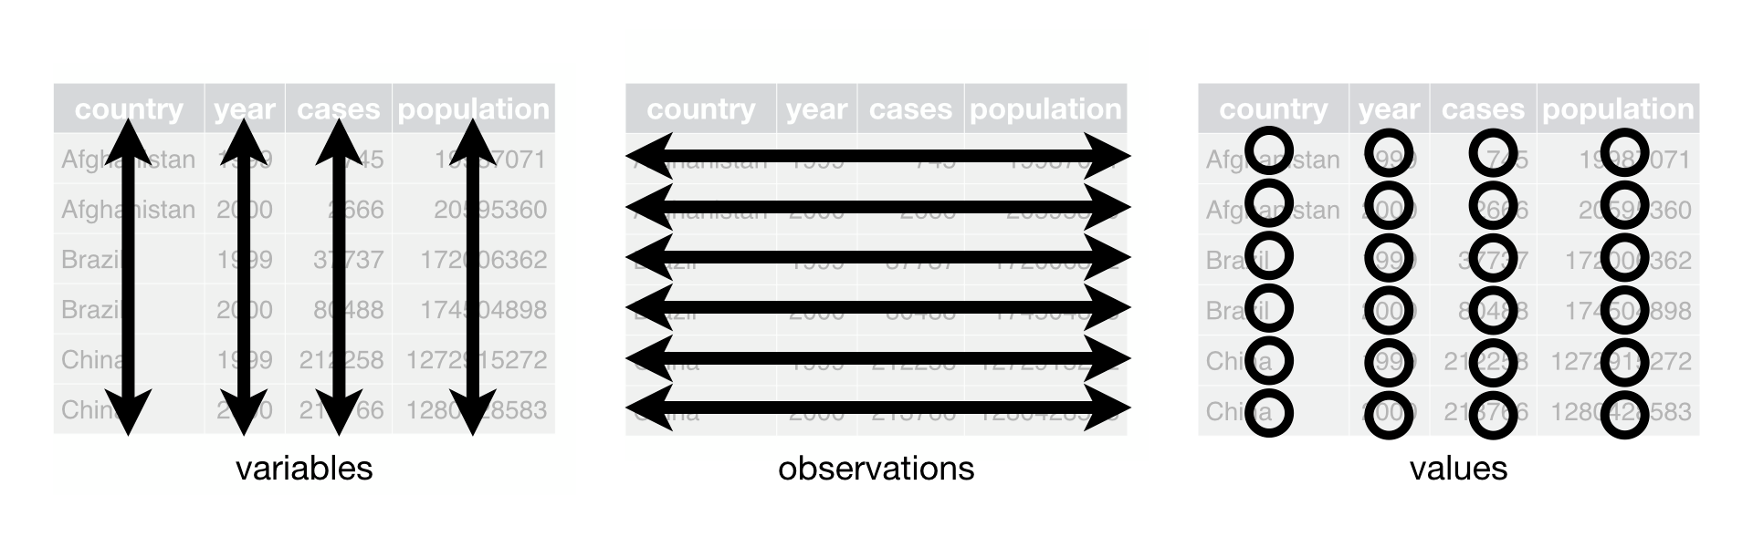
Tidy data schematic, from R for Data Science by Grolemund & Wickham:

Slide 39
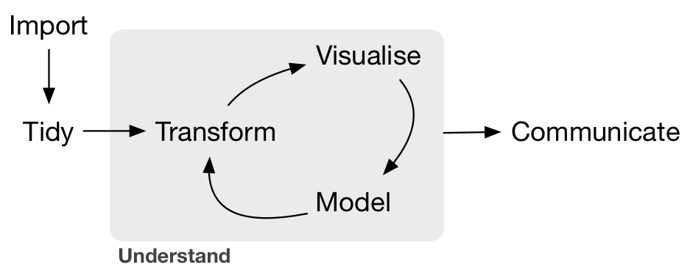
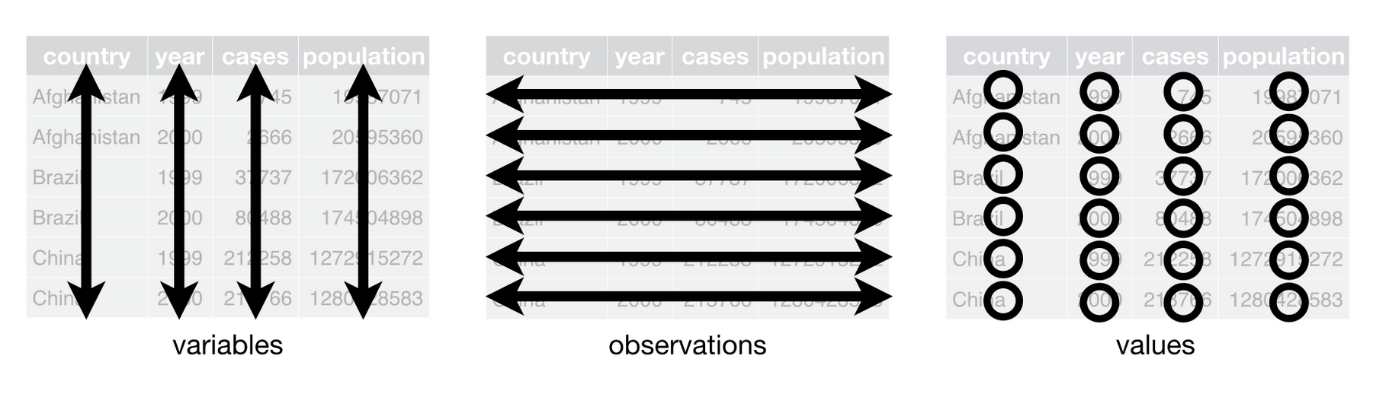
Tidy data
Three interrelated rules which make a dataset tidy:
Downstream operations require tidy data
1. Each variable has its own column.
2. Each observation has its own row.
3. Each value has its own cell.
Wickham & Grolemund 2016

Slide 40
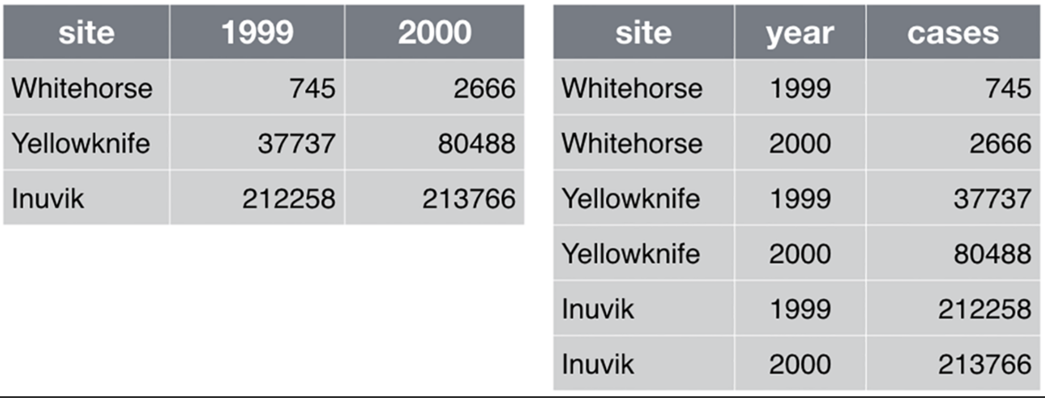
Tidy data
Untidy :(
Tidy!!
Good for data entry, not good for data analysis because
data are in column headers
not clear what the values are
variable is spread across multiple columns
(requires triangulation)
Great for data analysis because
Each variable has its own column.
Each observation has its own row.
Each value has its own cell.
What if you needed Whitehorse in 2000?

Slide 41
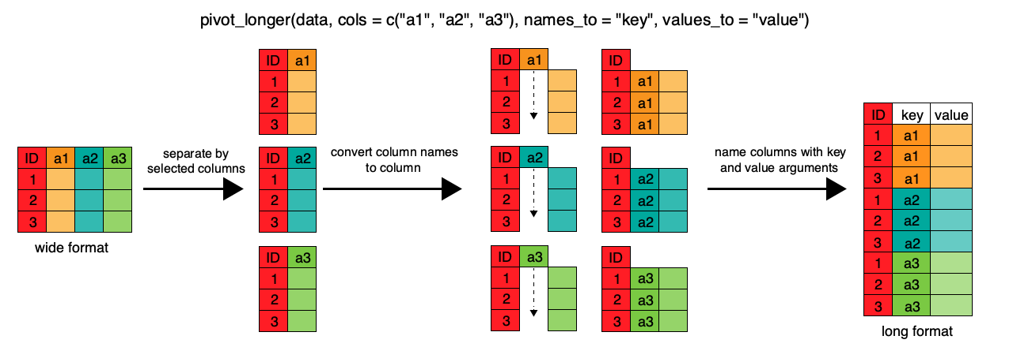
From Software Carpentry:
pivot_longer(data = df_name,
cols = c(a1, a2, a3),
names_to = “key”,
values_to = “value)

Slide 42
pivot_wider(data = df_name,
values_from = value,
names_from = key)

Slide 43
NOW you need kelp_fronds.xlsx
If you did not get an email from me this morning with the kelp_fronds.xlsx file attached, please let one of us know & we’ll email it to you. We’ll use it for Session 2.

Slide 44
Session 6: Filter & join

Slide 45
year | client | product | price_usd
2000 | Awesome Code | book | 12.99
2002 | Radical R | webpage | 25.50
2002 | Awesome Code | book | 18.25
2006 | Awesome Code | movie | 10.00
2013 | Delightful dplyr | webpage | 41.79
“I just want to isolate rows for our Awesome Code client”
“We want only data since 2005.”
“We want Awesome Code book values.”

Slide 46
filter(data = df_name, variable condition(s))
OR
df_name %>%
filter(variable condition(s))

Slide 47
*_join(df_x, df_y): deliberate merging

Slide 48
X
Y
Species | Year | Count
dragon | 2000 | 3
goose | 2002 | 10
dog | 2008 | 5
Species | Year | Name
dragon | 2004 | Falcor
dog | 2008 | Teddy
full_join(x,y, by = c(“Species”, “Year”))
Species | Year | Count | Name
dragon | 2000 | 3 | NA
goose | 2002 | 10 | NA
dog | 2008 | 5 | Teddy
dragon | 2004 | NA | Falcor

Slide 49
X
Y
Species | Year | Count
dragon | 2000 | 3
goose | 2002 | 10
dog | 2008 | 5
Species | Year | Name
dragon | 2004 | Falcor
dog | 2008 | Teddy
left_join(x,y, by = c(“Species”, “Year”))
Species | Year | Count | Name
dragon | 2000 | 3 | NA
goose | 2002 | 10 | NA
dog | 2008 | 5 | Teddy

Slide 50
X
Y
Species | Year | Count
dragon | 2000 | 3
goose | 2002 | 10
dog | 2008 | 5
Species | Year | Name
dragon | 2004 | Falcor
dog | 2008 | Teddy
inner_join(x,y, by = c(“Species”, “Year”))
Species | Year | Count | Name
dog | 2008 | 5 | Teddy

Slide 51
Session 7: Collaborating & Getting Help

Slide 52
Our plan this session
R communities & how to effectively ask for help (30 mins)
Googling. Error messages are your friends
How to use Twitter for #rstats
Create a reproducible example with reprex
GitHub Issues (brief interlude)
Write code collaboratively with a partner (60 mins)
create a new repo and give permission to a collaborator
publish your web pages online!

Slide 53
R communities connect online and in person
Most communities have some degree of in-person and online presence, with Twitter being a big part of that online presence.
That’s right: Twitter is a legit tool for learning R. We connect using the #rstats hashtag, and thus often called the “rstats community”.

Slide 54






RStudio Community
Online community forum for all questions R & RStudio
community.rstudio.com
Also: @RStudio
R Ladies
World-wide organization to promote gender diversity in the R community.
rladies.org, @rladiesglobal, local chapters
Also: @WeAreRLadies
rOpenSci
Building software with community; educating scientists about transparent research practices.
ropensci.org, @ropensci
Also: @roknowtifier, @rocitations
R Users Group
R User Groups (“RUGs”) are in-person meetups supported by the R Consortium.
local chapters
Ex: @la_Rusers, list of RUGs, confs
The Carpentries
Network teaching foundational data science skills to researchers worldwide
carpentries.org, @thecarpentries, local workshops
R4DS Community
A community of R learners at all skill levels working together to improve our skills.
@R4DScommunity, slack
Also: #tidytuesday, @R4DS_es
Notes:
30 seconds to introduce each of us 4

Slide 55
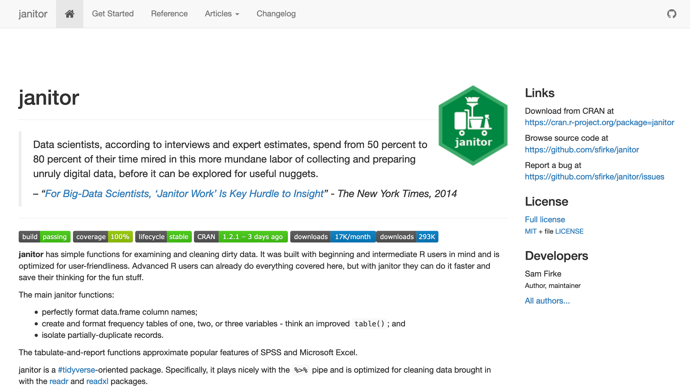
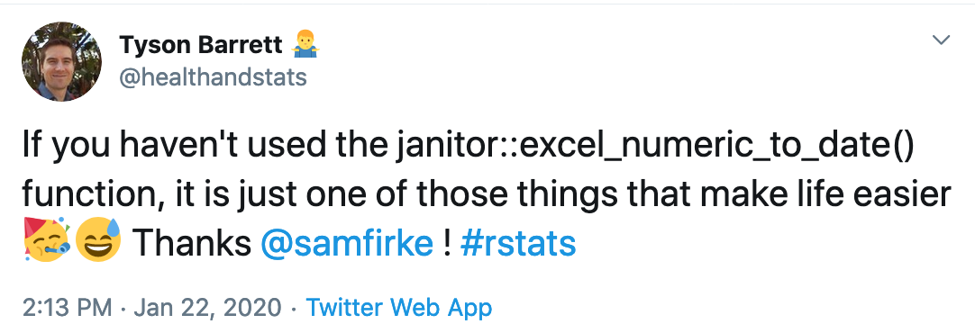
Example of #rstats community awesomeness
Openly shared with a website made with RStudio’s packagedown (RMarkdown)
I just learned about janitor’s excel_numeric_to_date
How? from Twitter:
Sam Firke’s janitor package: sfirke.github.io/janitor

Slide 56
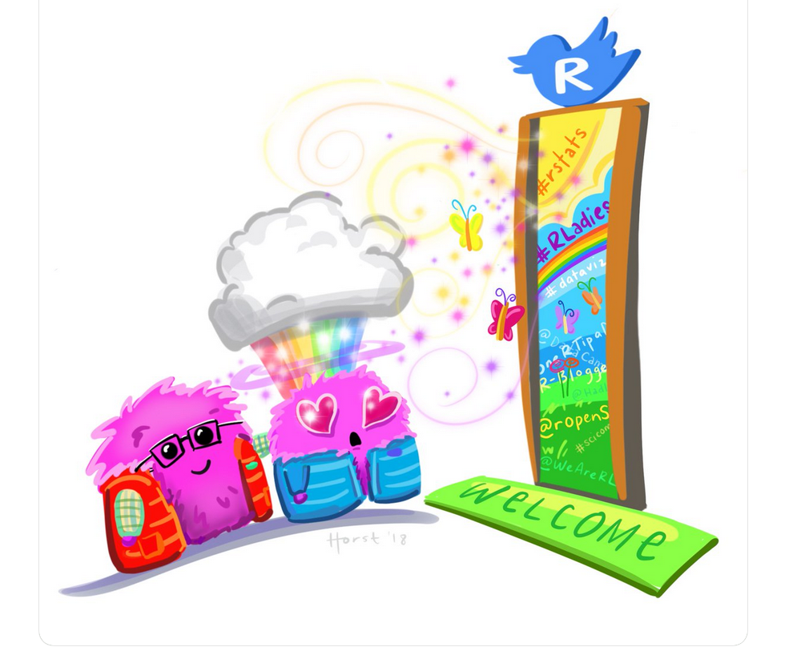

Slide 57
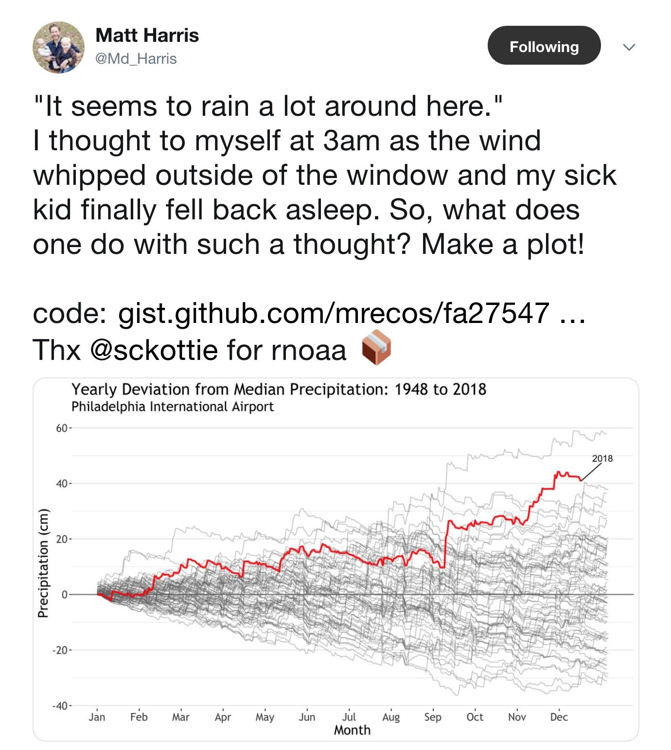
Using Twitter for R
My internal monologue:
Cool visualization!
I want to represent my data this way
He includes his code!
Package from @sckottie at rOpenSci
rnoaa is a package making NOAA data more accessible!
Click images to link to Tweets

Slide 58
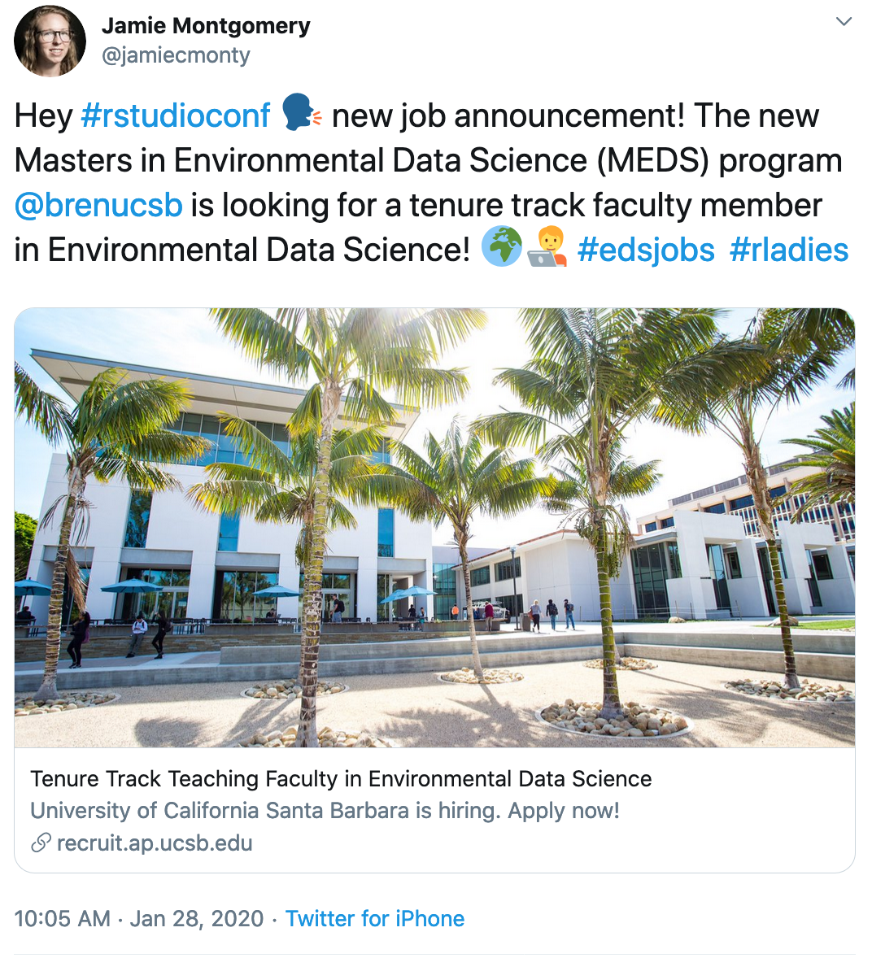
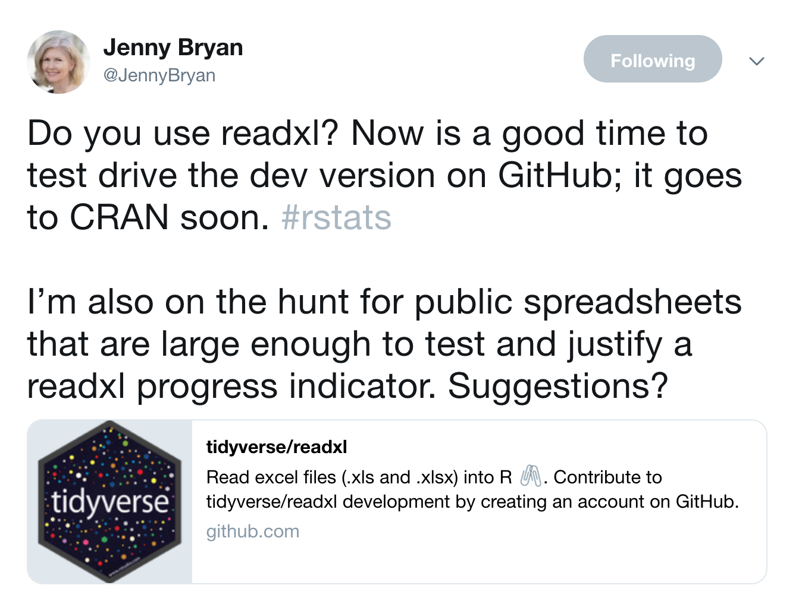
Using Twitter for R
Notes:
https://twitter.com/jamiecmonty/status/1222219279963058176

Slide 59
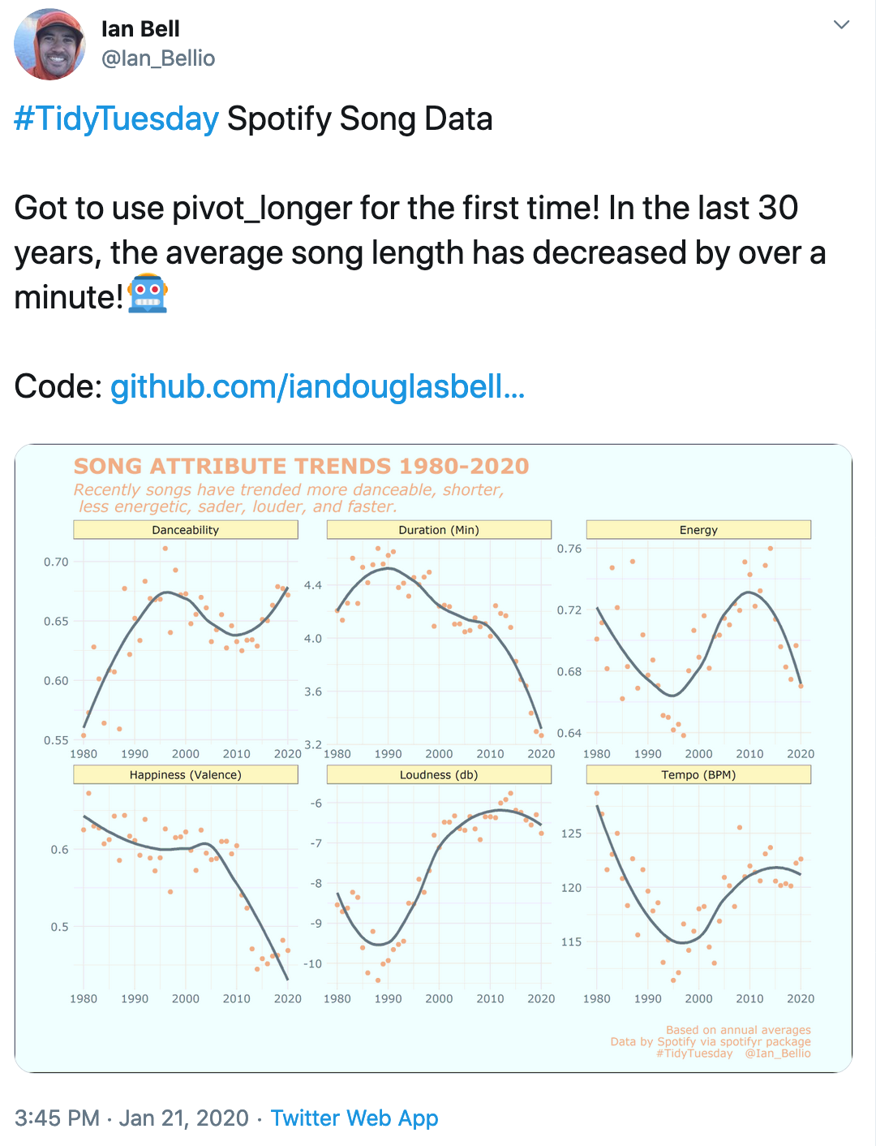
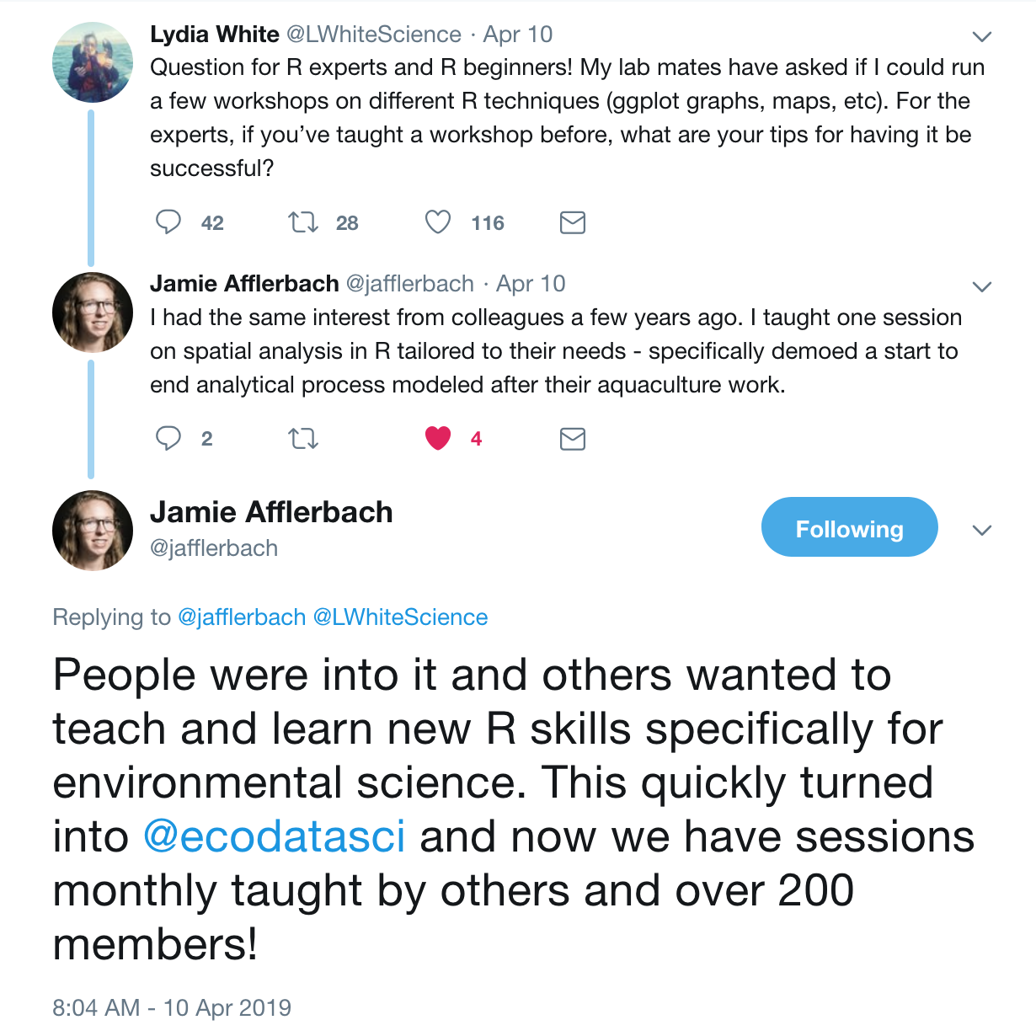
Strategies for learning: with community

Slide 60

How to Twitter (in my opinion, for #rstats)
Be deliberate. Curate who you follow and start by listening.
I use Twitter deliberately for R and science communities, so that is the majority of the folks I follow
(but I also follow Mark Hamill. @HamillHimself).

Slide 61
How to Twitter (in my opinion, for #rstats)
If you’re joining twitter to R, I suggest following:
@hadleywickham
@JennyBryan
@rOpenSci
@WeAreRLadies
Also check:
#rstats
#rstudioconf
You can also follow us:
@juliesquid
@allison_horst
@jamiecmonty
@ECOuture9

Slide 62
Getting help
Helping you help yourself means moving beyond “it’s not working” and towards solution-oriented approaches.
Part of this is the mindset where you expect that someone has encountered this problem before …
and that the problem is likely your typo or misuse, and not that R is broken or hates you.

Slide 63
library(tidyverse) # also attaches tidyr
smiths ## data loaded with tidyr
#> # A tibble: 2 x 5
#> subject time age weight height
#> <chr> <dbl> <dbl> <dbl> <dbl>
#> 1 John Smith 1 33 90 1.87
#> 2 Mary Smith 1 NA NA 1.54
smiths %>%
seperate(subject, into = c("first", "last"))
Error: 'seperate' is not an exported object from 'namespace:tidyr'

Slide 64
``` r
library(tidyverse)
ggplot(cars, aes(speed, dist)) +
geom_point()
```
![](https://i.imgur.com/g4ePvl5.png)
<sup>Created on 2020-01-28 by the [reprex package](https://reprex.tidyverse.org) (v0.3.0)</sup>

Slide 65
Our process:
Read the error message.
Paste error message into Google:
Error: 'seperate' is not an exported object from 'namespace:tidyr'
Refine Google search (abstract/divorce from your exact problem):
Error: is not an exported object from r
Click on RStudio Community Post:
Error: 'items' is not an exported object from 'namespace:cfsales'
“Could it be because the .rda is called item rather than items?”
Double-check seperate for typos, use RStudio’s autocomplete, copy-paste the function name
Whew.

Slide 66
reprex
reproducible examples

Slide 67
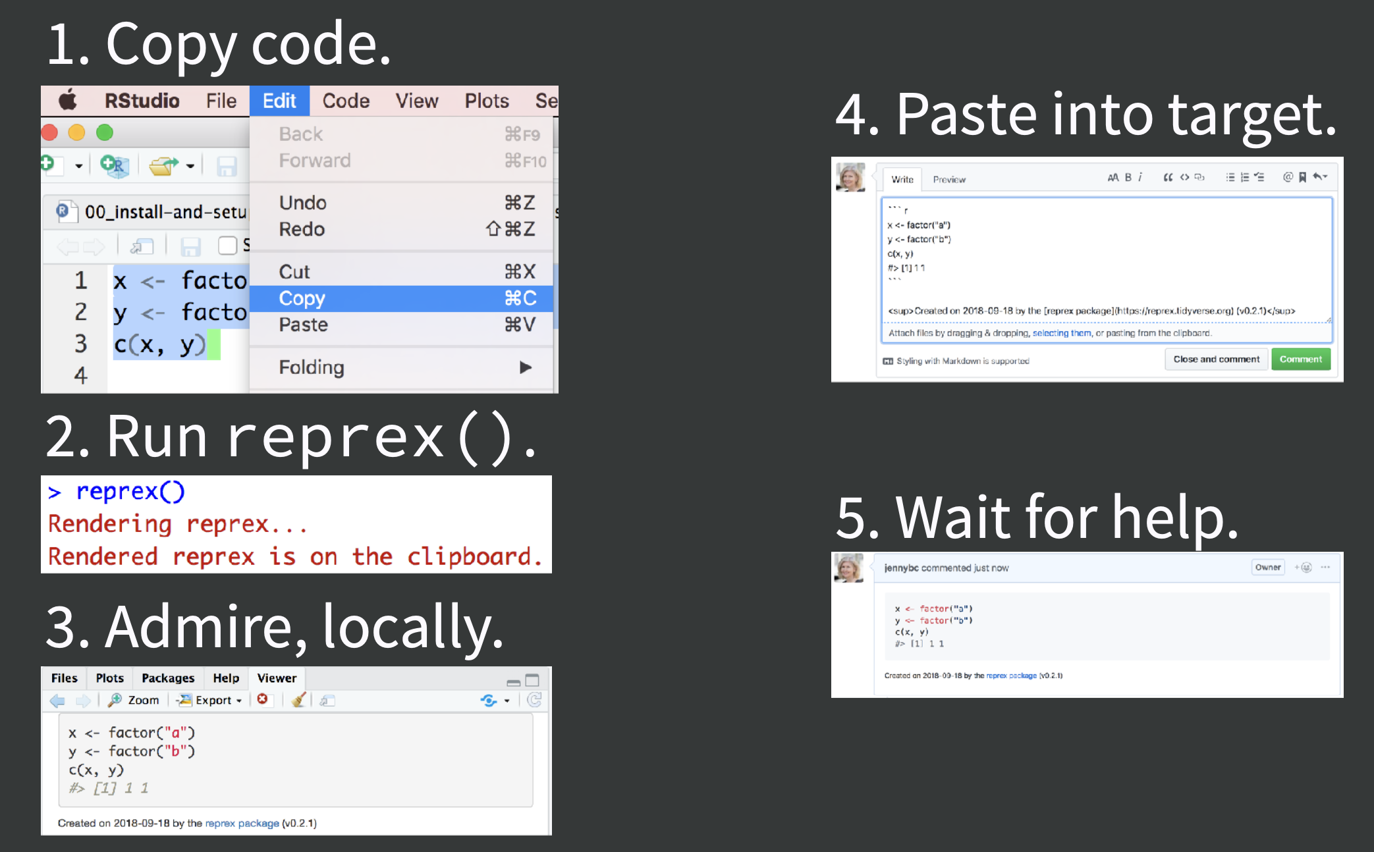
Notes:
Placeholder slide from Jenny’s speakerdeck https://speakerdeck.com/jennybc/reprex-reproducible-examples-with-r

Slide 68
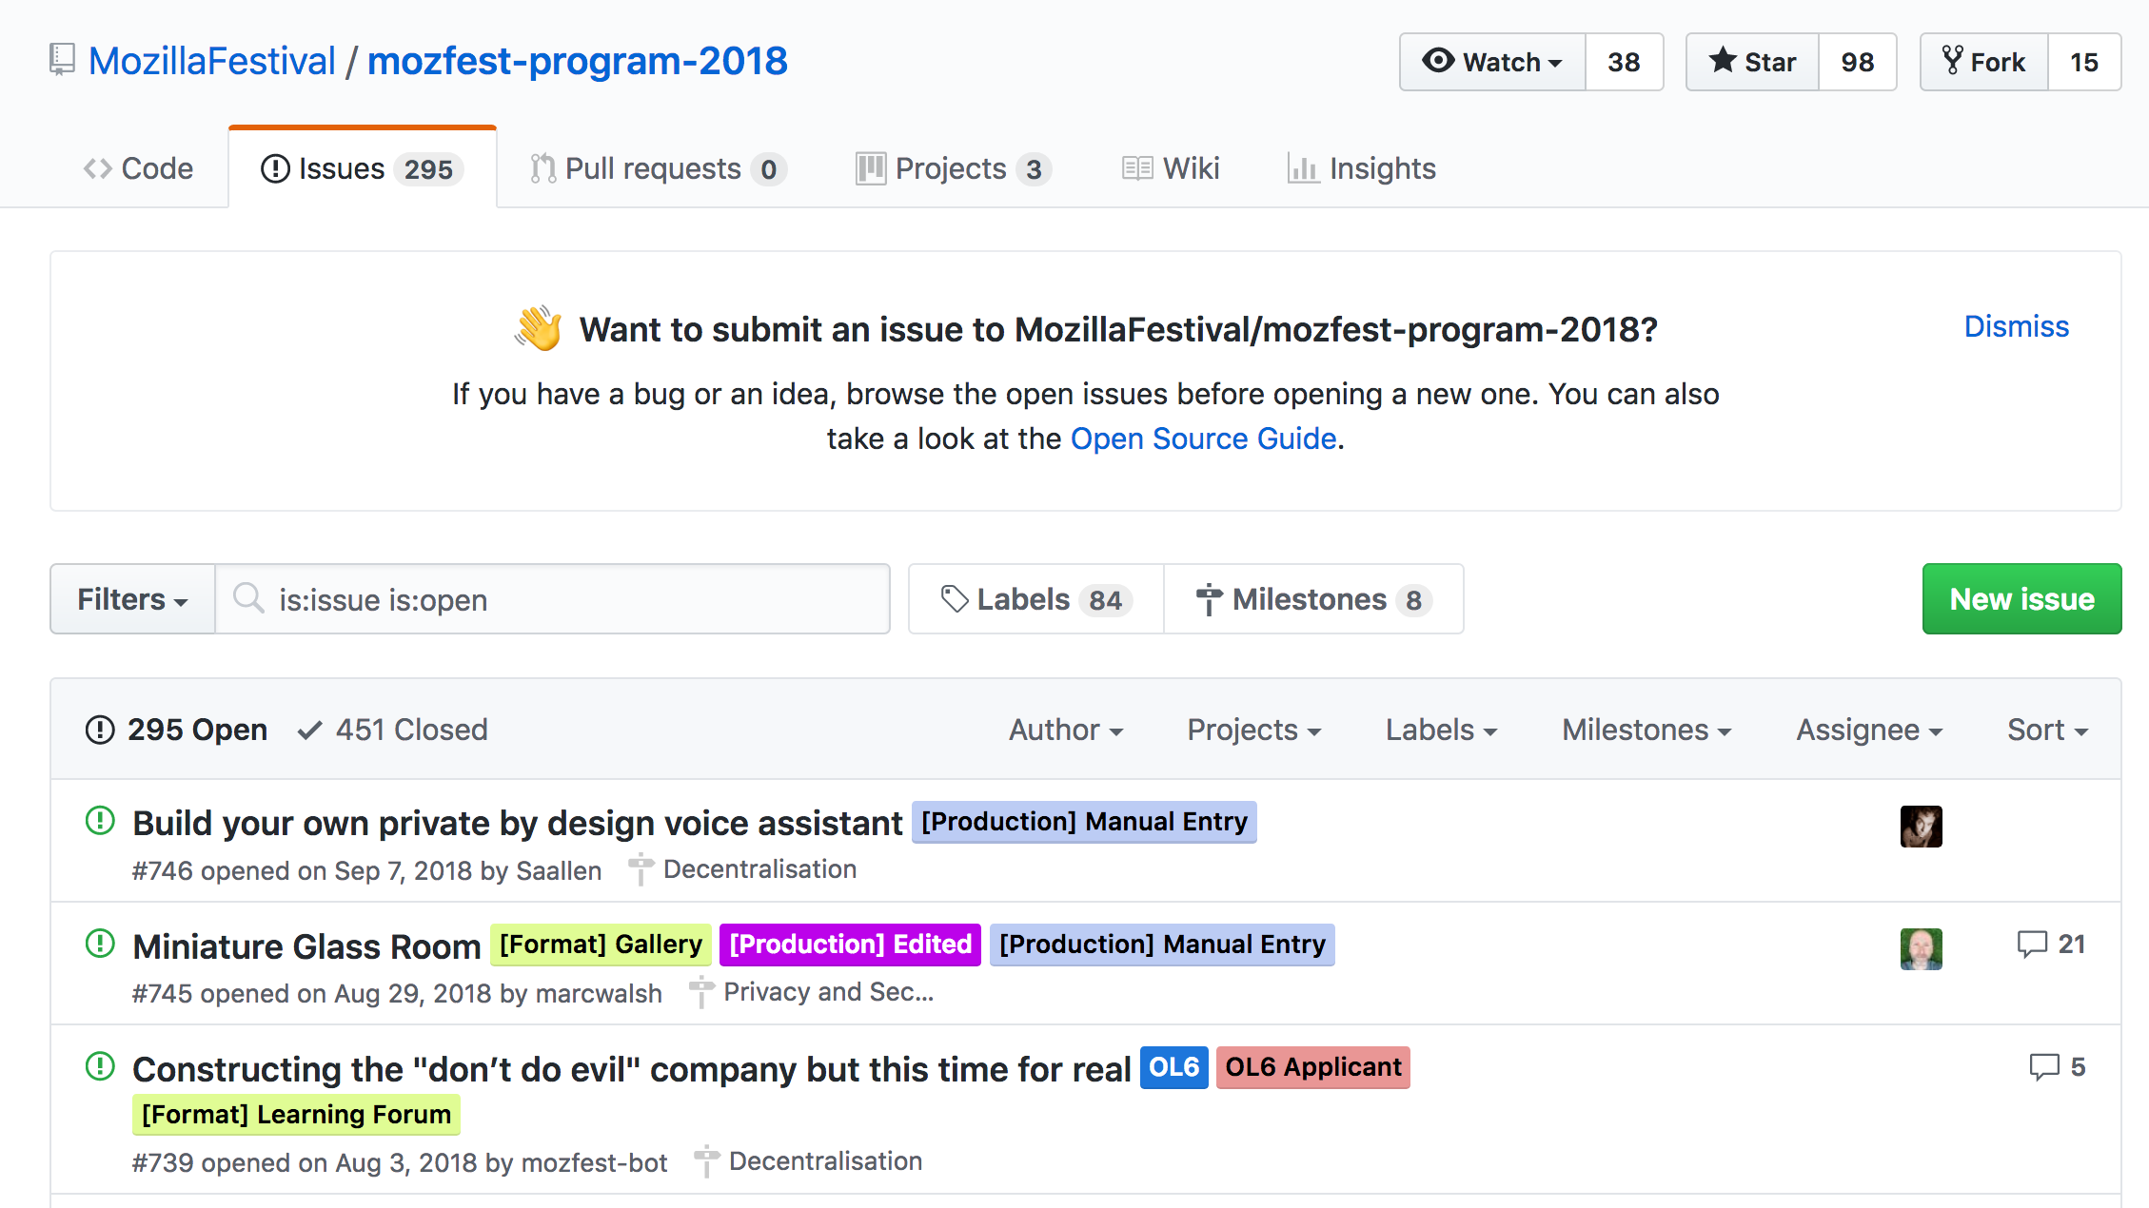
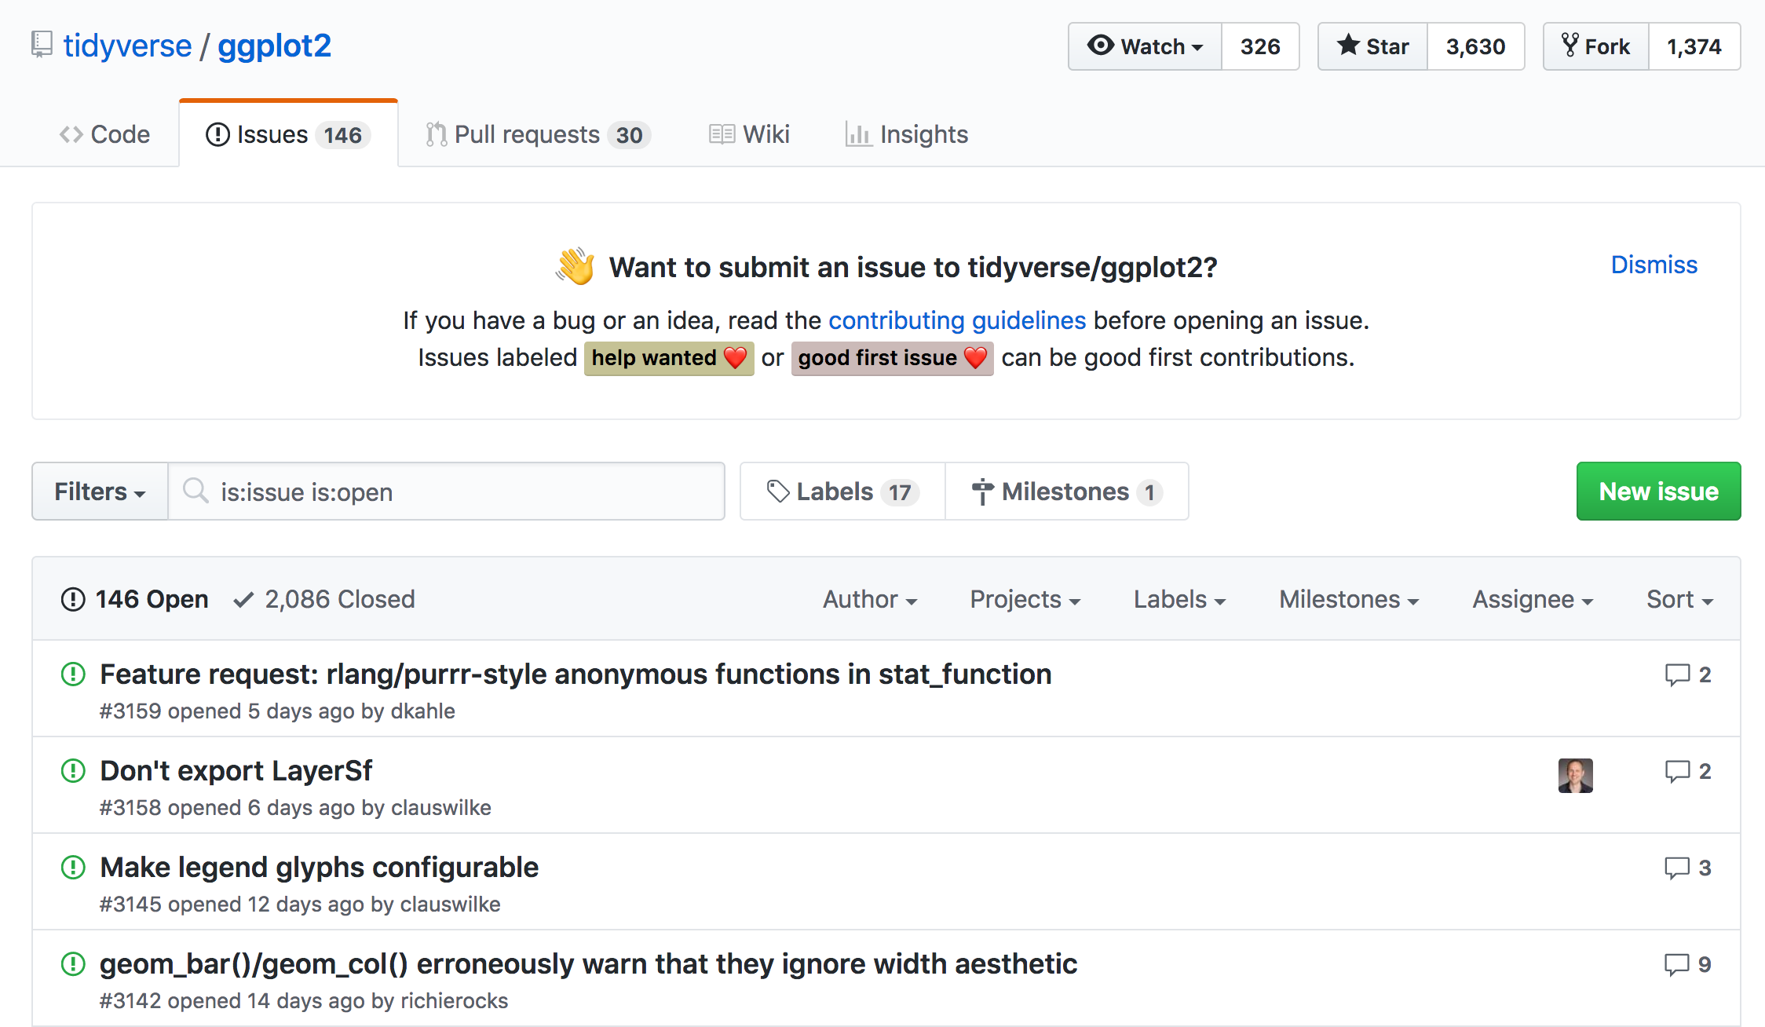
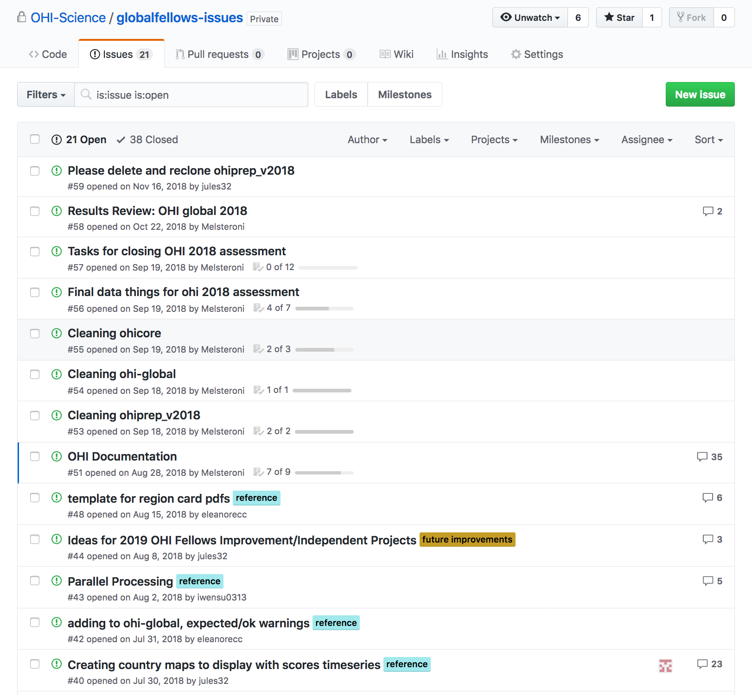
Issues in the wild
Project submissions and progress tracking
“traditional” and “less traditional”
Bug reports, code, feature, & help requests
Private conversations and archiving

Slide 69
Session 8: Synthesis
Before you leave, please take this short survey
(also available in the conference app)
rstd.io/ws-survey
And we will give out stickers

Slide 70
my github repo:
https://github.com/jules32/r-collab/
my website url:
https://jules32.github.io/r-collab/

Slide 71
Closing (10 min)

Slide 72
Overall, our system:
R for Data Science by Grolemund & Wickham
Notes:
Mention tidy data

Slide 73
What you did in this workshop:
Meet the RStudio IDE
Working in RMarkdown (2 languages! R + markdown)
Functions, arguments, code syntax & good habits
Writing organized, reproducible code, and the pipe operator (%>%)
Installing & attaching packages
Storing objects (<-)
Reading in and exploring data (read_csv, read_excel)
Reproducible file paths with ‘here’
Intro to visualization with ggplot2
Pivot tables (group_by + summarize)
An html table with kable
Hello Git + GitHub
Work between Git and RStudio (pull > stage > commit > push)
Reshaping, cleaning, wrangling data continued
Fun with strings
Deliberate filtering
Joining data frames
Collaborating in GitHub (co-working, a merge conflict!)
Building your community (and yes we discussed how to Twitter!)
Synthesis!
Publish document as a web page
tidyverse
ggplot2
readr
readxl
dplyr
tidyr
stringr
here
janitor
kableExtra
R
RStudio
Git
GitHub

Slide 74
Error messages should not feel defeating
Everyone gets them. At all levels. All the time.
Just because it’s red doesn’t mean it’s personal.
After a while we start seeing these as more useful, and develop tools to more strategically troubleshoot.
Whenever possible, have error messages feel like:
A useful heads up
An opportunity to learn something
A puzzle that you can solve

Slide 75
Where to go from here?
Main tool: Google it...strategically
CRAN Task view
rOpenSci
The Carpentries: https://carpentries.org/
Join #rstats community on twitter, even if just for the #rstats!
Some starting-point resources:
R4DS book & online learning community
RStudio community
Our workshop book! https://rstudio-conf-2020.github.io/r-for-excel
Materials from other RStudio::conf tutorials (e.g. tidyverse)
Blog posts, tutorials, vignettes on packagedown pages (e.g. janitor)
Webinars & slide decks (e.g. RStudio::conf Keynote Jenny Bryan)
Podcasts e.g. NSSD Spreadsheet Drama (by RStudio::conf Keynote Hilary Parker & Roger Peng)

Slide 76
This was an introduction but there are a lot of people working on making it easier to get started in R and RStudio, begin working between RStudio and GitHub, and there is a lot of effort to improve working between R and excel.
For example, tidycells: r-rudra.github.io/tidycells
And: nacnudus.github.io/spreadsheet-munging-strategies

Slide 77
As important as developing R skills yourself is enabling others around you
This benefits you!
Talk to your colleagues about coding and reproducible workflows. Some conversation-starters:
Our path to better science in less time using open data science tools - Lowndes et al. 2017, Nature E&E
Supercharge your research: a ten-week plan for open data science - Lowndes, Horst et al. 2019, Nature
Open Software Means Kinder Science – Lowndes 2019 Scientific American
Openscapes.org

Slide 78
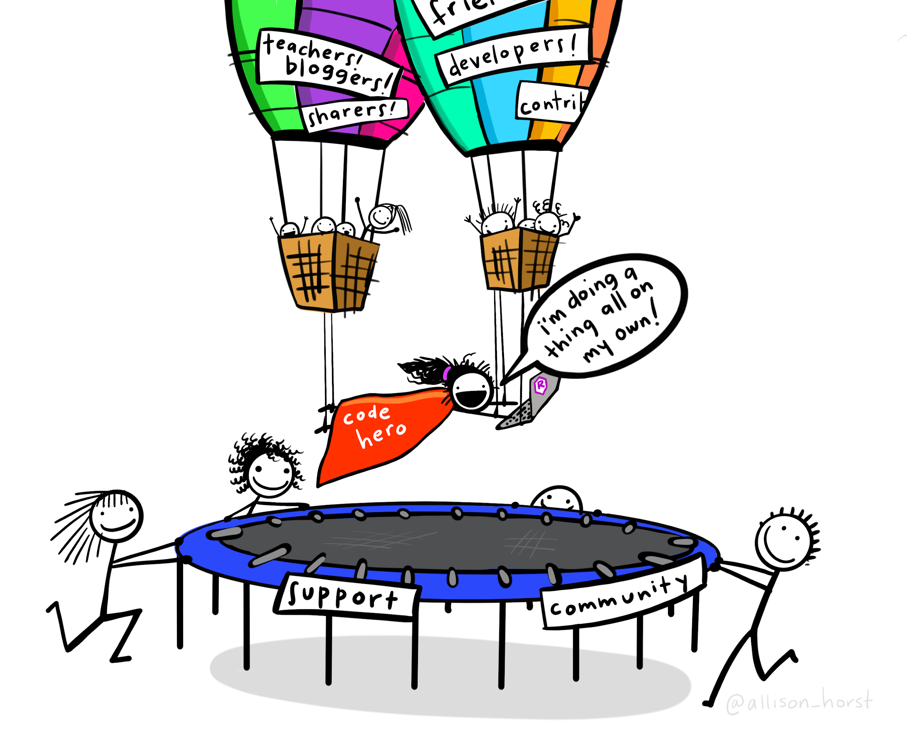

Slide 79
THANK YOU for your participation, we look forward to seeing you all at the conference over the next 2 days!
Please take this short survey:
rstd.io/ws-survey

